Slide 1
Training Neural networks to play checkers
Daniel Boonzaaier
Supervisor – Adiel Ismail
April 2017

Slide 2
Content
Project Overview
Checkers – the board game
Background on Neural Networks
Neural Network applied to Checkers
Requirements
Project Plan
References
Questions

Slide 3
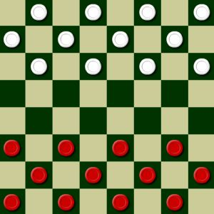
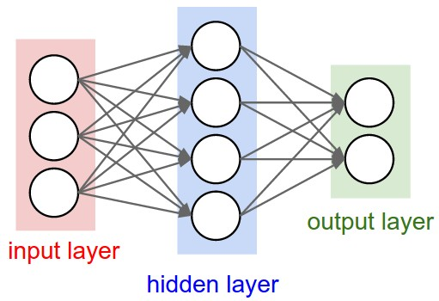
Project Overview
Why this project?
A program that teaches itself Checkers
Checkers – Complete Information
Neural Network

Slide 4
Checkers – the Board Game
Two player board game
Played on a board sectioned into 64 squares
Each player has 12 pieces
The goal is to remove all to opponents pieces.
Pieces can only move diagonally forward.
When a piece reaches the end of the board they are “kinged” and can then move in both directions.
Multiple jumps can occur so long as there are corresponding empty spaces for the piece to jump to.
If an opportunity to jump is present it must be taken.

Slide 5
Background on Neural Networks
What is a Neural Network?
Machine Learning Algorithm.
Input propagates through the network to get an output.
An error is gained from output with what is expected.
Update network by going back through the network.
Update till error is acceptably small.

Slide 6
Background on Neural Networks
Has an input, a hidden and an output layer.
Nodes are fully connected by weights.
Calculation in the hidden layer to produce an output.
Training is done on a set of inputs with back propagation used to update weights.
Update weights till error is acceptably small.
Once trained the weights are fixed for testing.

Slide 7
Neural Network applied to Checkers
Checkers board will be represented by the 32 places on the board where a piece can be placed.
The 32 places will be the inputs.
Calculate scores of all possible moves.
Move with highest score should be chosen.

Slide 8
Requirements
Learn from just given rules with no external help.
Neural network must not be over trained.
Play checkers to at least average human competency.

Slide 9
Project Plan
Term 1 – Research
Research related works and determine requirements
Term 2 – Designing and Prototyping
Design program and neural net
Term 3 – Implementation of Design
Create program and train neural net
Term 4 – Testing and Refining
Test competency and refine program if necessary

Slide 10
References
A. L. Samuel, “Some Studies in Machine Learning Using the Game of Checkers”, IBM Journal, Vol 3, No. 3, (July 1959)
K. Chellapilla, D. B. Fogel, “Evolving Neural Networks to Play Checkers Without Relying on Expert Knowledge”, IEEE Transactions on Neural Networks, Vol. 10, No 6, (Nov 1999)
N. Franken, A. P. Engelbrecht, “Evolving intelligent game-playing agents”, Proceedings of SAICSIT, Pages 102-110, (2003)
N. Franken, A. P. Engelbrecht, “Comparing PSO structures to learn the game of checkers from zero knowledge”, The 2003 Congress on Evolutionary Computation. (2003)
A. Singh, K. Deep, “Use of Evolutionary Algorithms to Play the Game of Checkers: Historical Developments, Challenges and Future Prospects”, Proceedings of the Third International Conference on Soft Computing for Problem Solving, Advances in Intelligent Systems and Computing 259, (2014)

Slide 11
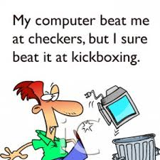
Questions?

