Slide 1
Training Neural networks to play checkers
Daniel Boonzaaier
Supervisor – Adiel Ismail
June 2017

Slide 2
Content
Recap
High Level Design
Low Level Design
References
Prototype
Project Plan

Slide 3
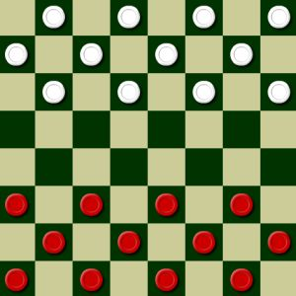
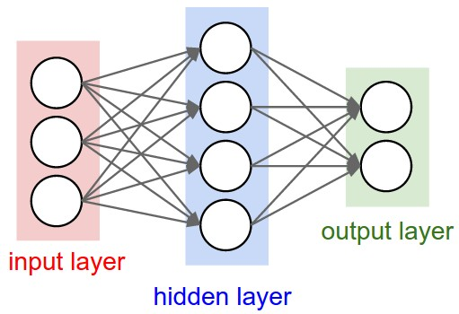
Recap
Checkers
Neural Network
Neural Network evaluates board positions to find best move.

Slide 4
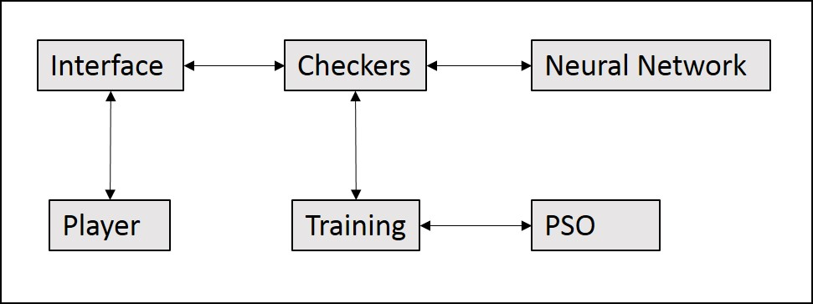
High Level Design

Slide 5
Low Level Design
Checkers
Neural Network
Particle Swarm Optimization
Training

Slide 6
Checkers
 | 28 |  | 29 |  | 30 |  | 31
24 |  | 25 |  | 26 |  | 27
 | 20 |  | 21 |  | 22 |  | 23
16 |  | 17 |  | 18 |  | 19
 | 12 |  | 13 |  | 14 |  | 15
8 |  | 9 |  | 10 |  | 11
 | 4 |  | 5 |  | 6 |  | 7
0 |  | 1 |  | 2 |  | 3
Board positions are a list of size 32 made up of 1, -1, 2, -2 and 0.
Moves determined by index of board position.
Odd rows, plus 3 or 4 forward and -4 or -5 backward.
Even rows plus 4 or 5 forward and -3 or -4 backward.
Jumps 7 or 9 forward or -7 and -9 backward.
During games, valid moves will be obtained and then each move will be evaluated by a neural network.
The move with the highest score is chosen.
even
odd
Board with index of positions.
 | -1 |  | -1 |  | -1 |  | -1
-1 |  | -1 |  | -1 |  | -1
 | -1 |  | -1 |  | -1 |  | -1
0 |  | 0 |  | 0 |  | 0
 | 0 |  | 0 |  | 0 |  | 0
1 |  | 1 |  | 1 |  | 1
 | 1 |  | 1 |  | 1 |  | 1
1 |  | 1 |  | 1 |  | 1
even
odd
Board with values of positions.

Slide 7
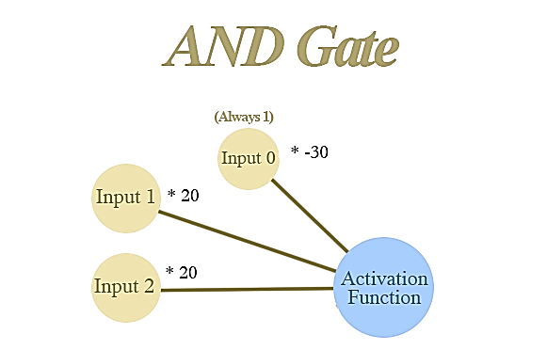
Neural Network
Neural Network Agent
= Weights [-30, 20 ,20]
Example Neural Network
Input 1 = x1 | Input 2 = x2 | Formula = | Result = r | Sigmoid =
0 | 0 | -30 + 0*20 + 0*20 | -30 | 0
1 | 0 | -30 + 1*20 + 0*20 | -10 | 0
0 | 1 | -30 + 0*20 + 1*20 | -10 | 0
1 | 1 | -30 + 1*20 + 1*20 | 10 | 1
$$x_{0}∗−30$$
$$+ x_{1}∗20 + x_{2}∗20$$
$$\frac{1}{1+e^{−x}}$$

Slide 8
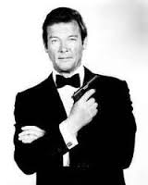
Neural Network Cont.
An agent represents a neural network and is a vector made up of its weights.
Agents consist of 171 = 5 * (32 + 1) + (1 * 6) weights including biases.
A number of agents will be used to play games of checkers.
Each agent will play randomly vs 5 other agents in population.
e.g. agent 1 vs 3, 7, 11, 18 and19.
Outcome of games calculated as 1 (win), -2 (loss) and 0 (draw).
Fitness of agent calculated as the sum of the output of all five games.
e.g. agent1 = 1 + 1 -2 + -2 + 0 = -2
Agent 1
Agent 2
Agent 3
Agent K

Slide 9
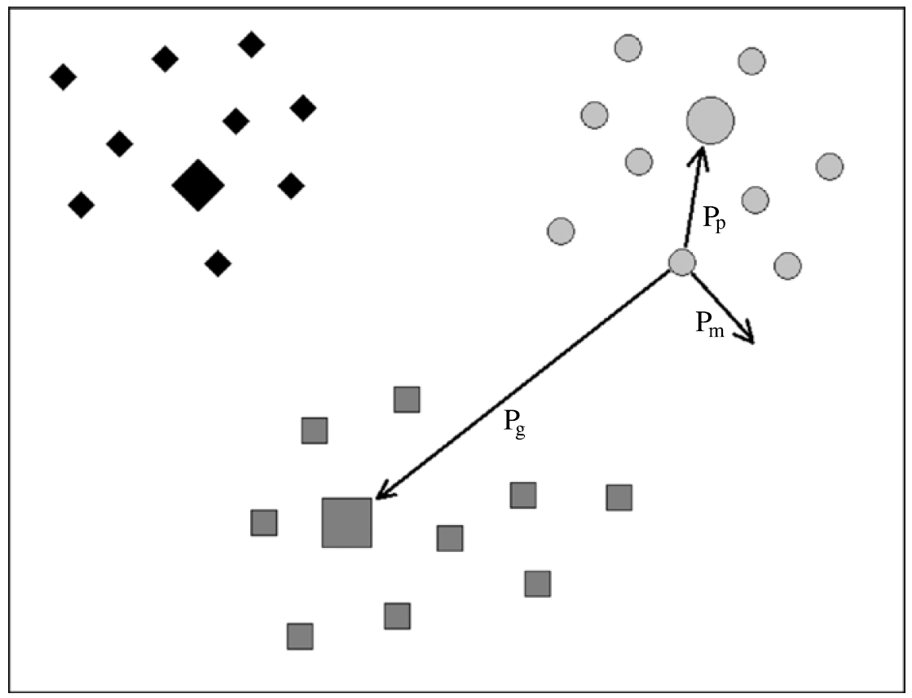
Particle Swarm Optimization
Swarm will consist of all the agents plus a copy for each agent representing its personal best.
Personal best is each agents best fitness value since the start.
The Global best, best of all the particles, is recorded.
Velocity is updated using agent’s personal best and global best.
Weights of each agent are updated according to the velocity function.
Personal Best
Global Best
Agent

Slide 10
Training
Repeat 500 times
For each agent k
Fitness[k] ⇦ 0
For 5 opponent
Opponent ⇦ select random agent
Outcome ⇦ playGame(k, opponent)
Fitness[k] ⇦ Fitness[k] + outcome
For each agent k
Update personal best and global best.
Update velocity of agent k.
Update position of agent k.
The PSO will fine tune the weights of the neural networks.
After training is complete the global best agent will be ready to play against.

Slide 11
References
A. L. Samuel, “Some Studies in Machine Learning Using the Game of Checkers”, IBM Journal, Vol 3, No. 3, (July 1959)
K. Chellapilla, D. B. Fogel, “Evolving Neural Networks to Play Checkers Without Relying on Expert Knowledge”, IEEE Transactions on Neural Networks, Vol. 10, No 6, (Nov 1999)
N. Franken, A. P. Engelbrecht, “Evolving intelligent game-playing agents”, Proceedings of SAICSIT, Pages 102-110, (2003)
N. Franken, A. P. Engelbrecht, “Comparing PSO structures to learn the game of checkers from zero knowledge”, The 2003 Congress on Evolutionary Computation. (2003)
A. Singh, K. Deep, “Use of Evolutionary Algorithms to Play the Game of Checkers: Historical Developments, Challenges and Future Prospects”, Proceedings of the Third International Conference on Soft Computing for Problem Solving, Advances in Intelligent Systems and Computing 259, (2014)

Slide 12
Prototype
Checkers Game Example

Slide 13
Game Start

Slide 14
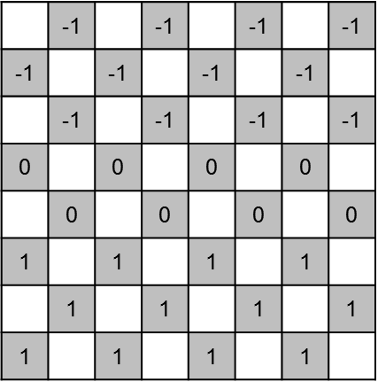
Evaluation of Checkers Board
0 | 1
1 | 1
2 | 1
… | …
… | …
30 | -1
31 | -1
Score of board

Slide 15
Calculate score of moves
Move | Neural Network Score
8 ➔ 12 | 0,5
9 ➔ 12 | 0,6
9 ➔ 13 | 0,5
10 ➔ 13 | 0,4
10 ➔ 14 | 0,6
11 ➔ 14 | 0,5
11 ➔ 15 | 0,9
Highest Score = 0.9
Move made = 11 ➔ 15

Slide 18
14 ⇨ 21 ⇨ 28
Chosen as better than
14 ⇨ 23
Or
20 ⇨ 24
Or
20 ⇨ 29

Slide 20
 | game 1 | game 2 | game 3 | game 4 | game 5 | Fitness
agent 1 | -2 | 1 | -2 | -2 | 1 | -4
agent 2 | 1 | 0 | 1 | 0 | -2 | 0
agent 3 | 0 | 1 | -2 | -2 | 0 | -3
agent 4 | 1 | 0 | -2 | -2 | -2 | -5
agent 5 | 0 | 0 | -2 | -2 | 0 | -4
agent 6 | 1 | 0 | 1 | 1 | -2 | 1
agent 7 | -2 | -2 | 1 | 1 | 0 | -2
agent 8 | 1 | -2 | 0 | 0 | 0 | -1
agent 9 | 0 | -2 | -2 | 0 | -2 | -6
agent 10 | 0 | 0 | 0 | 0 | -2 | -2
agent 11 | -2 | 0 | -2 | 1 | 0 | -3
agent 12 | -2 | 0 | -2 | -2 | 1 | -5
agent 13 | 0 | 1 | 0 | -2 | -2 | -3
agent 14 | 1 | -2 | -2 | 0 | 0 | -3
agent 15 | 0 | 0 | 0 | 0 | -2 | -2
agent 16 | 0 | 1 | -2 | -2 | -2 | -5
agent 17 | -2 | 0 | 0 | 0 | 1 | -1
agent 18 | -2 | -2 | 0 | -2 | -2 | -8
agent 19 | 0 | -2 | 0 | -2 | -2 | -6
agent 20 | 1 | 0 | 1 | 1 | 0 | 3
Training Example
Obtaining fitness of particles
Global best = Agent 20

Slide 22
Benchmark – Games Played with Randomly Selected Moves

Slide 23
Project Plan
Term 1 – Research ✓
Research related works and determine requirements
Term 2 – Designing and Prototyping ✓
Design program and neural net
Term 3 – Implementation of Design
Create program and train neural net
Term 4 – Testing and Refining
Test competency and refine program if necessary

Slide 24
Questions?

