Slide 1
Data Visualizer for CommCare
Intership-linked project with Dimagi to assist CommCare users with visualizing their data.
By: Faieez White
Supevisor: Prof William Tucker

Slide 2
What is Dimagi
Dimagi is a software social enterprise that develops software to improve service delivery in underserved communities.

Slide 3
What is CommCare?
Dimagi is an open source platform designed for front line workers globally to help with gathering and distributing data.

Slide 4
The Problem
Spotting trends from spreadsheets are difficult.
Poring over a spreadsheet is tideous.

Slide 5
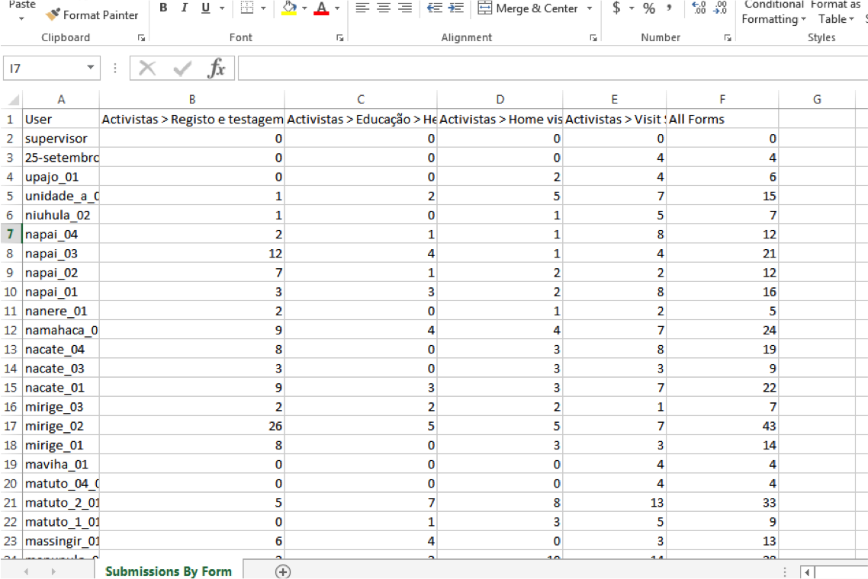

Slide 6
The Solution: Data Visualizer in the form of a web application
The human brain responds better to graphical representations of data and spots trends much easier.
Therefore allowing a user to perform analysis on the data collected and stored in the CommCare database.

Slide 7
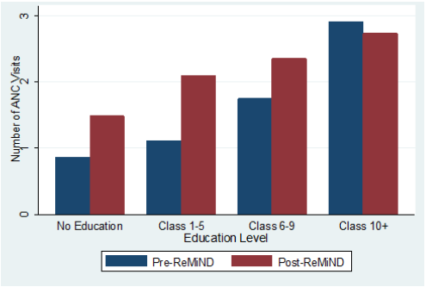
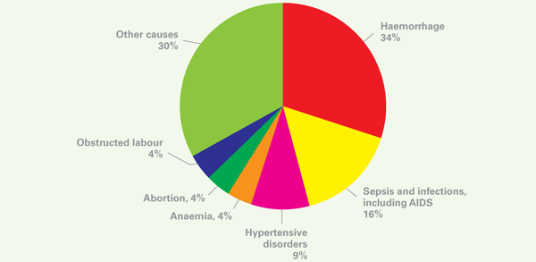
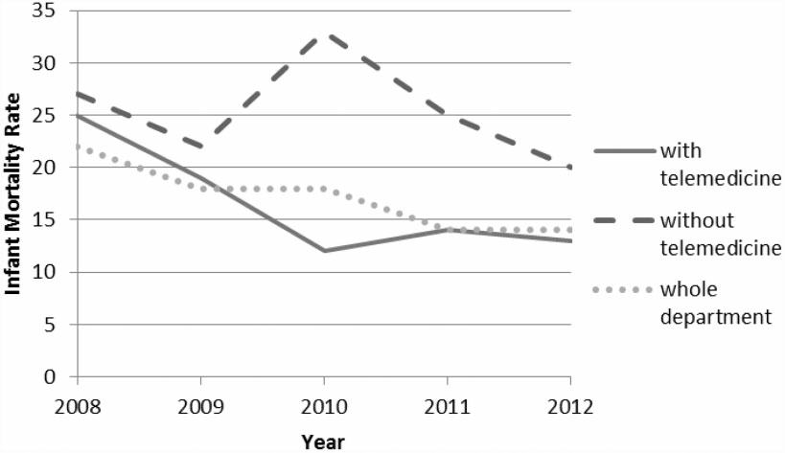
Visualizing Data

Slide 8
Responsive web application

Slide 9
Responsive web design
A responsive design will automatically change the dimensions of a web site when it detects the size of the screen of the device it is being launched on.

Slide 10
User Requirements
A web browser.

Slide 11
User Requirements
A desktop computer or mobile device.
Internet Connectivity.
A web browser.

Slide 12
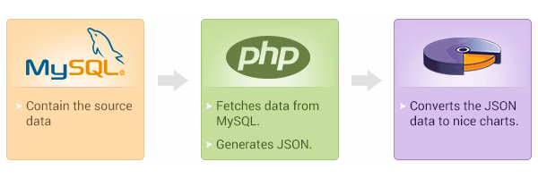
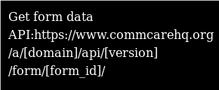
Requirements analysis

Slide 13
Project Plan for Term 2
-Obtain sample data from Dimagi representative.
-Download all tools required for the development process.
-Begin the design and construction of the prototype web application.
-Create use case diagrams.
-User Interface.
-High level Design.
-Low Level Design.
-Create a storyboard.
-User test the prototype and video record the testing.
-Complete the documentation for term two.
-Do term two’s presentation

