Slide 1
Data Visualizer for CommCare
Intership-linked project with Dimagi to assist CommCare users with visualizing their data.
By: Faieez White
Supevisor: Prof William Tucker

Slide 2
What is CommCare?
CommCare is an open source platform designed for front line workers globally to help with gathering and distributing data.

Slide 3
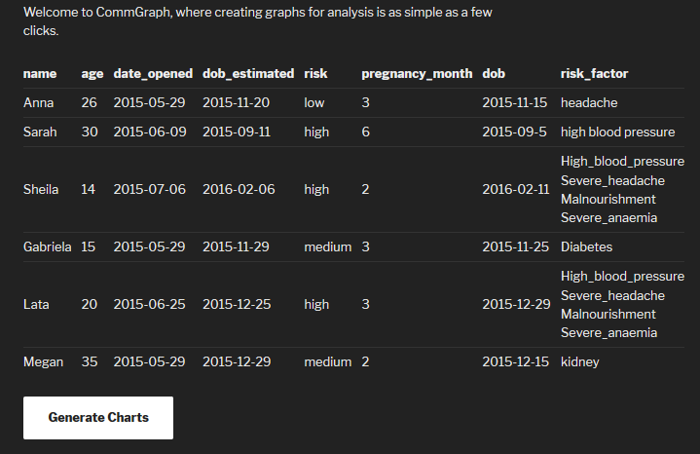
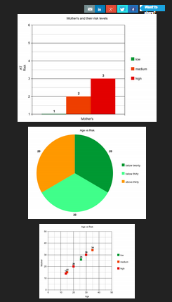
Project recap: Visualizing Data
SOLUTION: A web application that visualizes data from the CommCare database.

Slide 4
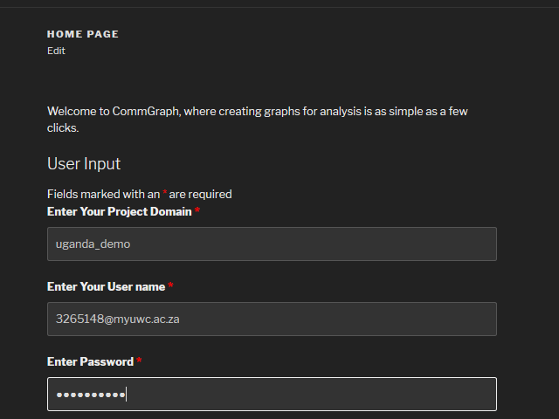
User Interface Specification

Slide 5
The Table

Slide 6
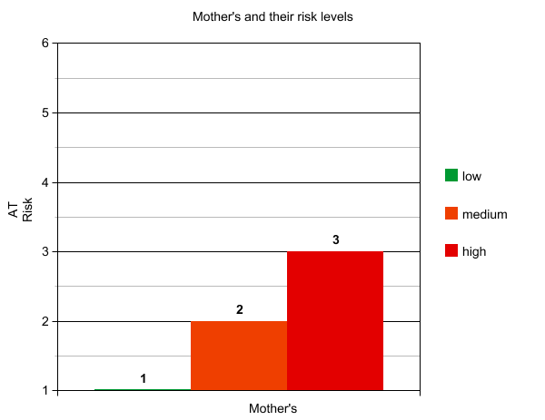

Slide 7
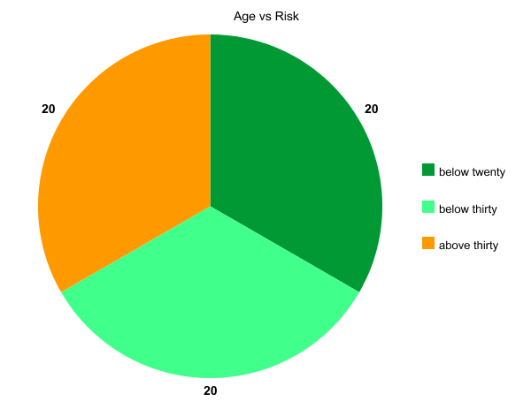

Slide 8
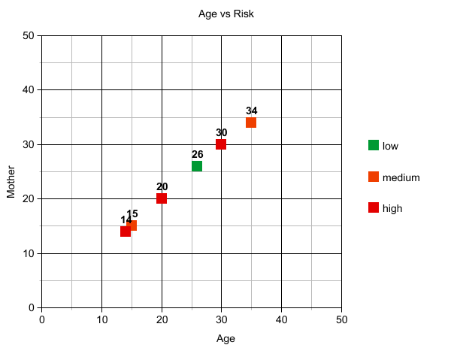

Slide 9
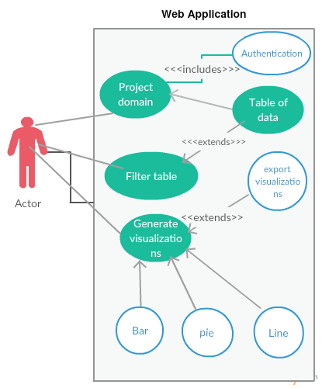
High Level Design

Slide 10
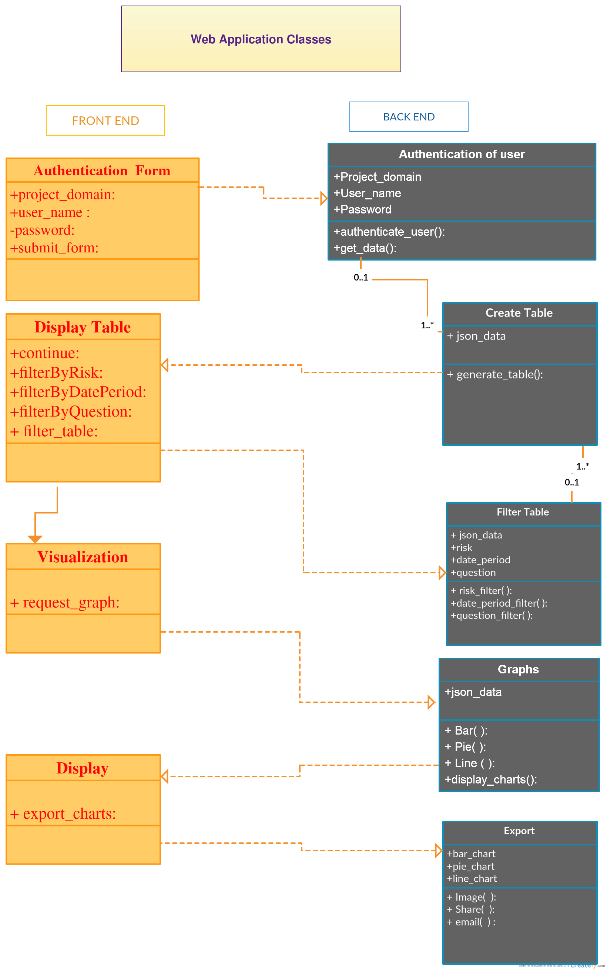

Slide 11
Low Level Design
All attributes get types.
All functions get parameters.
Functions get return values or are void.

Slide 13
Project Plan for Term 3
Implement first version of the web app.
Implement all the components described in term two.
Add functions for the user to interact with the graphing process.
Do more user testing.(video record).
Collect opinions from other programmers.
Improve implementation based on criticism.

Slide 14
Liaise with Dimagi representative.
Do some minor rework of documentation and add term three's findings.
Do term three's presentation.

