Slide 1
Data visualizer for CommCare
Intership-linked project with Dimagi to assist CommCare users with visualizing their data.
By: Faieez White
Supervisor: Prof. William Tucker

Slide 2
an open source platform designed for front line workers globally to help with gathering and distributing data.

Slide 3
Project Recap
PROBLEM
Need to visualize data to perform better analysis.
SOLUTION
CommChart is an open source web application that allows a user to visualize data in the form of charts.

Slide 4
Project Plan
Term 1: Research, user requirements, requirements analysis
Term 2: Design, user interface specification, prototype
Term 3: Implementation
Term 4: Testing
- Function test
- Platform independence test
- Integration test

Slide 5
Testing
Unit test
Testing each function that makes up the charting web application.
Platform independent test
Testing the web application’s ability to adjust to different device screen dimensions.

Slide 6
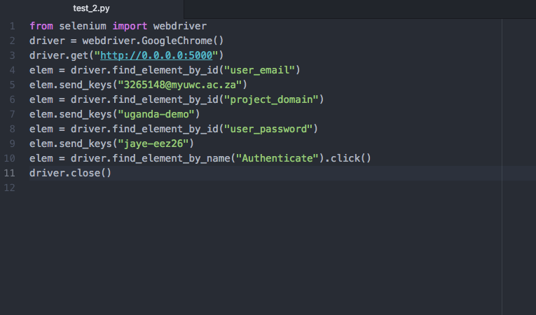
Test script for data retrieval API

Slide 7
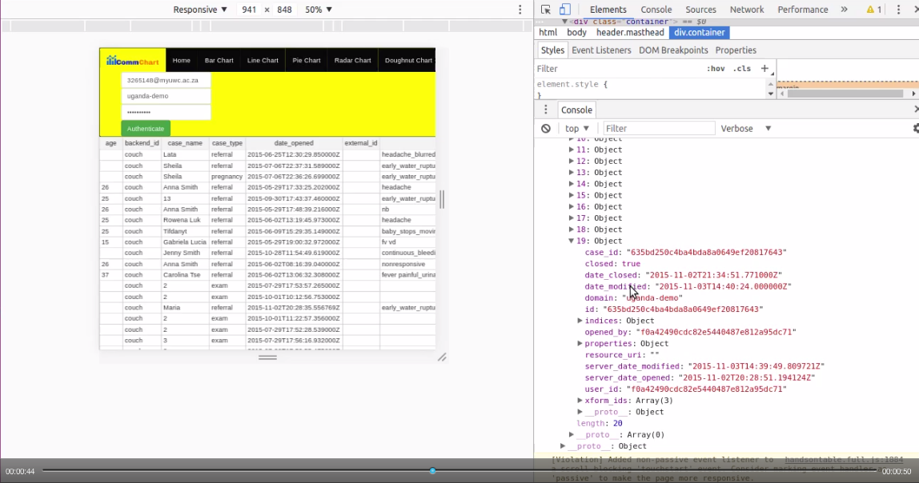

Slide 8
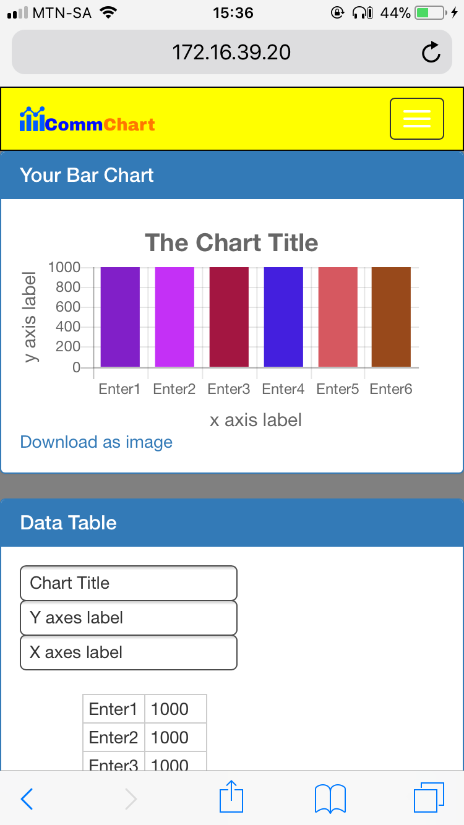
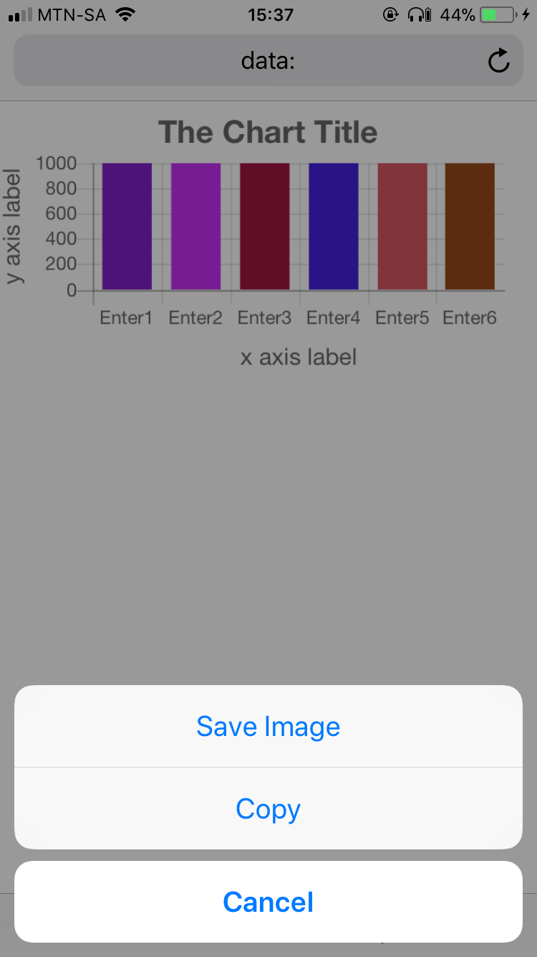

Slide 9
Challenges with platform independence
Unable to copy and paste successfully on mobile device every time.
Virtual keyboard on mobile device does not show up successfully every time.

Slide 10
Future work
Fix the platform independence challenges.
Present the prototype to Dimagi.

