Slide 1
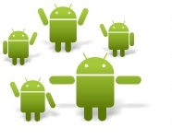
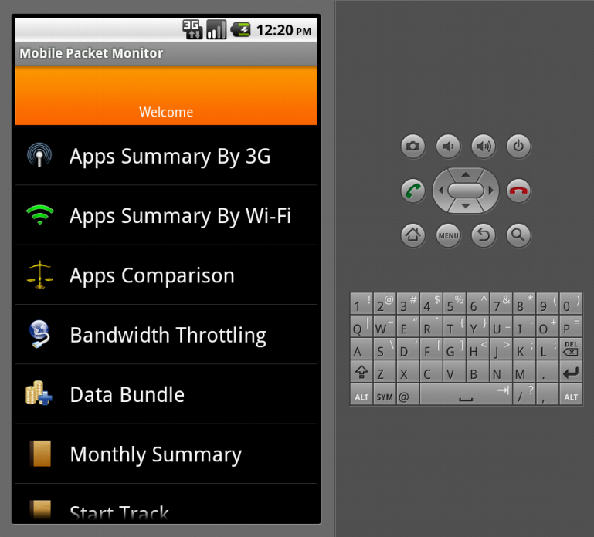
MOBILE PACKET MONITOR
By Josue Martins & Chisha Malama
Supervisor Dr. B.W Tucker
& Co-Supervisor Mr. M. Norman
Notes:
Spell out UI as User Interface using a 2nd line
Practice to get the timing right as you only have 6 slides of which only 4 have stuff to talk about – most of your time will be spent on slides 2,3 an 4 – so make sure you speak sufficiently to these slides; don’t need to spend much time in slide 5 – just do it briefly;

Slide 2
Overview
Introduction
Technology Used
How does it work
Demo
References

Slide 3
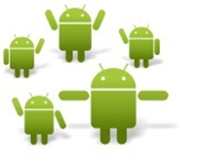
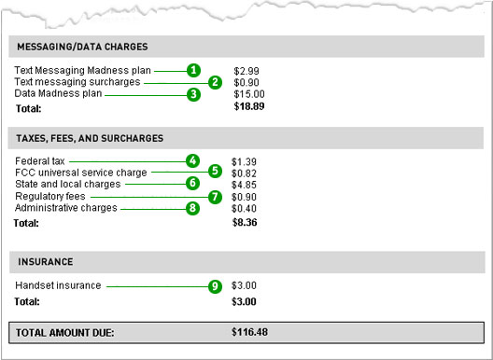
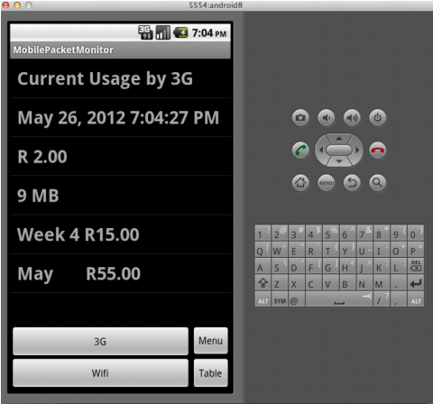
Introduction
What is an Mobile Packet Monitor software?
Monitors data usage
Adds a cost to data usage
Works on Android OS 2.2 Froyo to the latest versions of Android OS
Runs in the background
Stores data usage accumulatively
Why is the Mobile Packet Monitor important?
It will provide awareness of data Usage and cost.
It will help users make better financial decisions on internet Data usage.
Mobile users
Expensive Mobile phones Bills
Solution
Android packet monitor

Slide 4
Technology Used
Eclipse IDE
Android SDK
Java
XML
Android Mobile Phone
Internet Data bundle
Notes:
When ever its my tern just point at me

Slide 5
How does it work
Tracks bytes being sent/received
Detects the application sending/receiving bytes
Uses a database to store all collected information
Is able to retrieve totals based on each application

Slide 6
FRONTEND BACKEND COMMUNICATION
Frontend App
By J. Martins
Backend App
C. Malama
Android OS

Slide 7
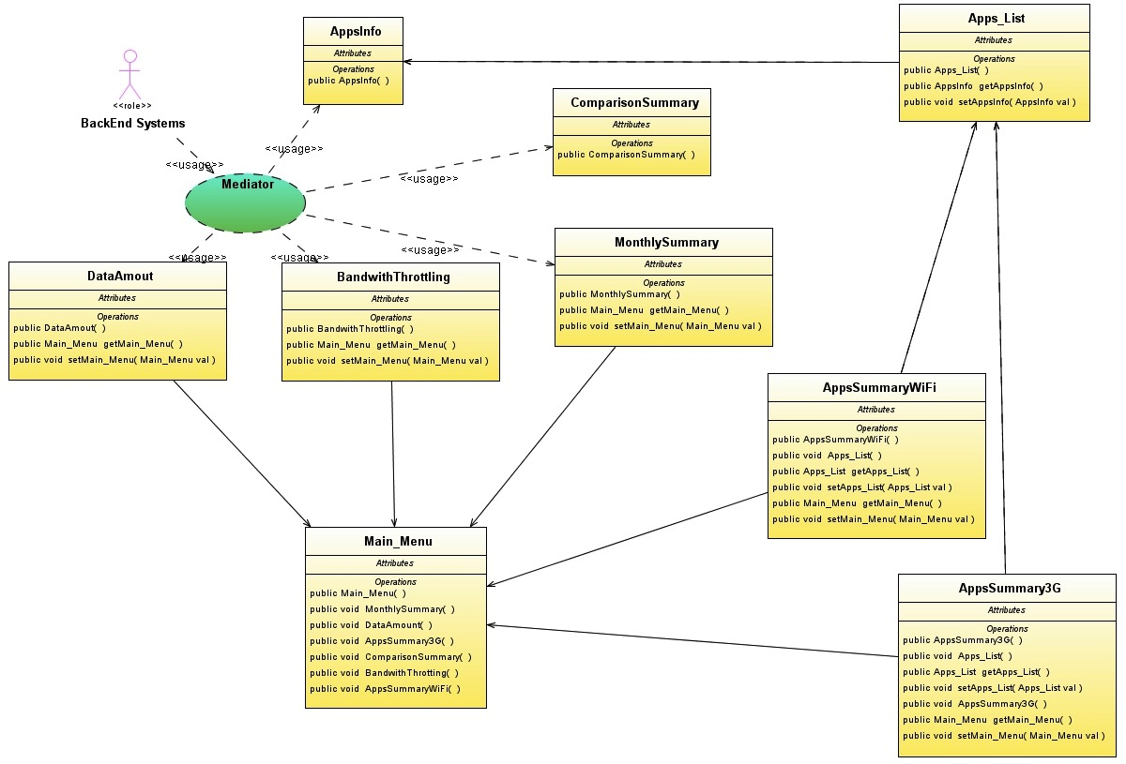
Front End High Level Design

Slide 8
Main Menu

Slide 9
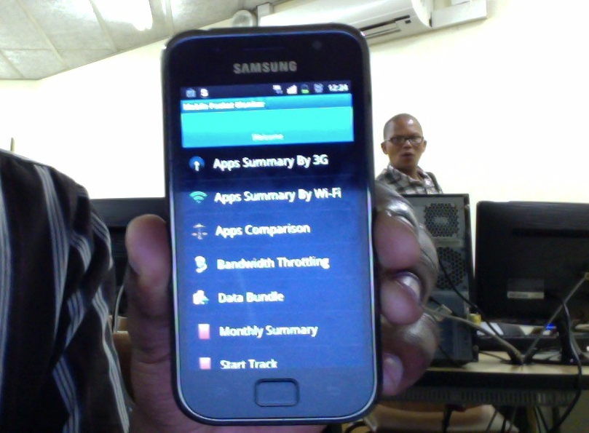

Slide 10
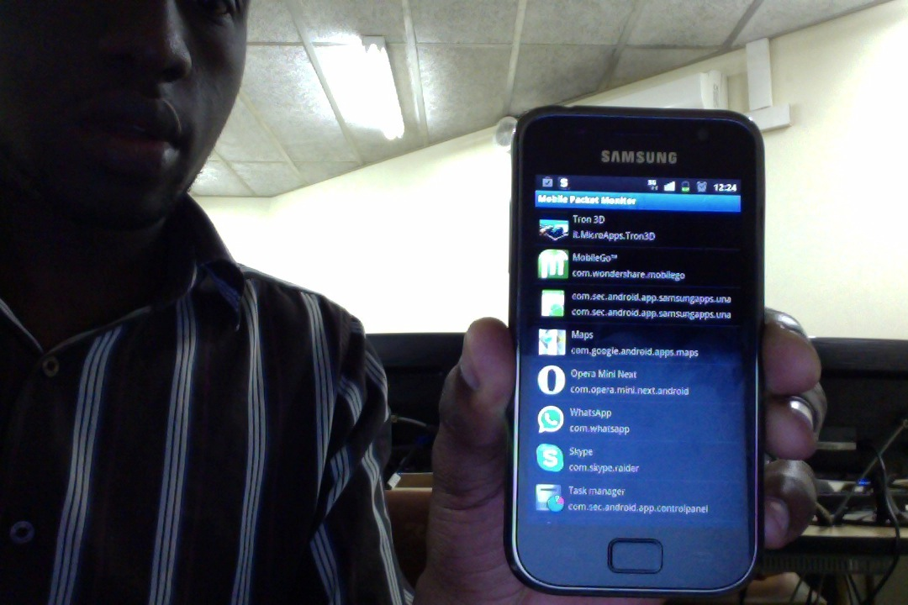

Slide 11
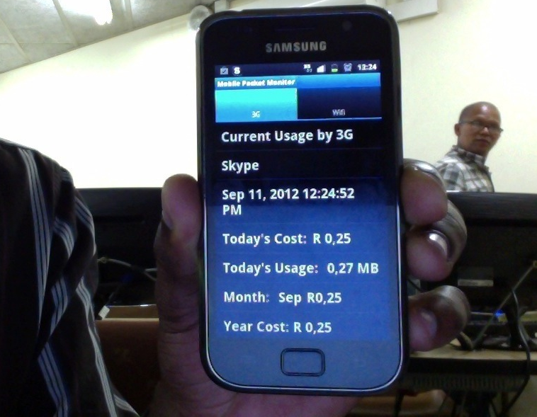

Slide 12
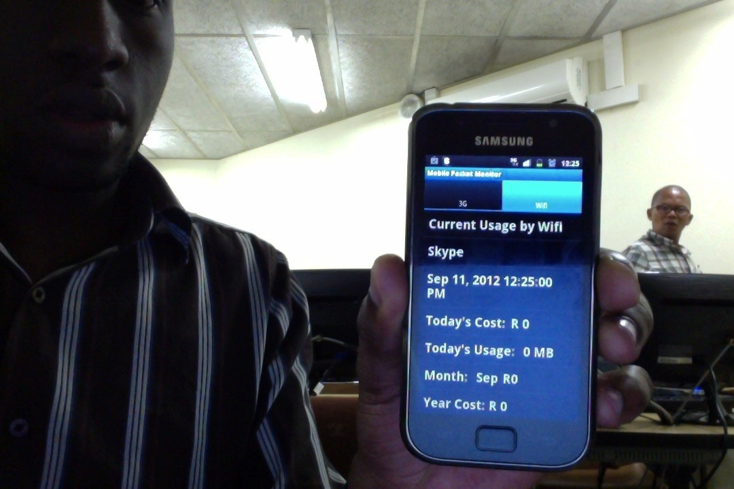

Slide 13
ANDROID OS Wi-Fi TRAFFIC
Service Class
MonitorTraffic Class
ANDROID OS 3G DATA TRAFFIC
Management Class
Mediator Class
WifiReadWrite Class
ThreeGReadWrite Class
Frontend App
ContentProvider Class
SQLite Database

Slide 14
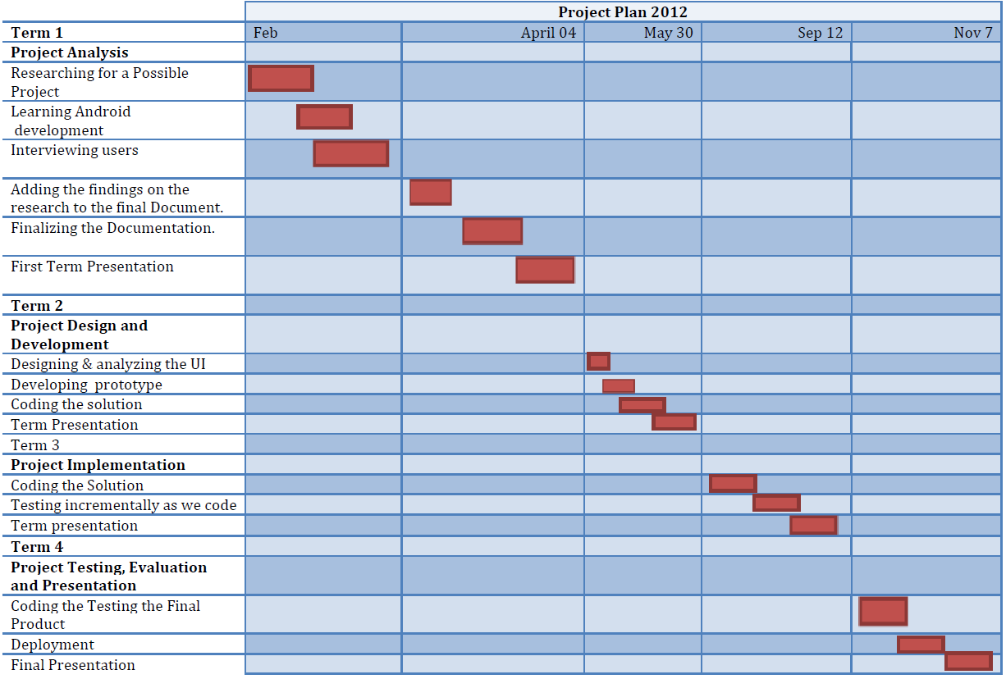

Slide 15
Term 4 in Depth.
 | Term 4
Project Testing, Evaluation and Presentation
Review user requirements
Debug errors
Documentation
Research different data rate
Document Findings
Embed data rates to code
Improve data retrieval speed
Test all changes
Finalize Project
Final Presentation

Slide 16
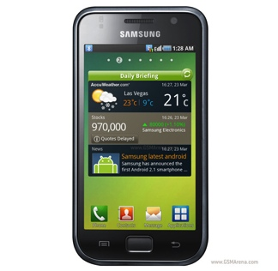
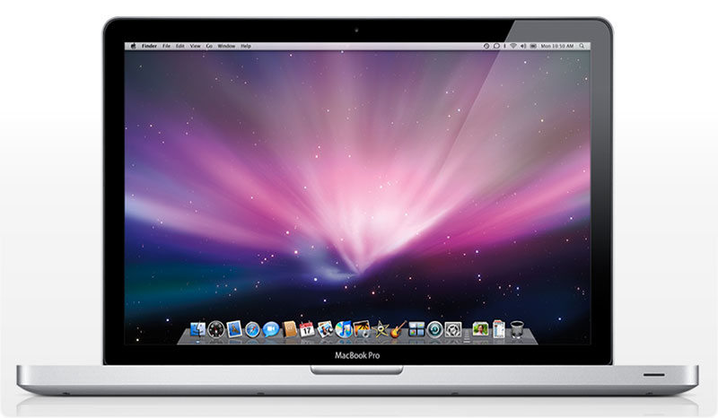
Demo
Skype call to
Samsung S Plus MacBook Pro
Download some Files
Show the usage
Use Skype or any other App
Show usage

Slide 17
References
Mobile Application Development http://www.webmapsolutions.com/mobile-arcgis-paper-gps-data-collection
Chen, Jason (12 May 2008). "The Top 50 Applications". Android Developers Blog. Retrieved 2009-09-04.
Leslie, Ben (13 November 2007). "Native C application for Android". Benno's blog. Retrieved 2009-09-04.
http://source.android.com/source/building-devices.html
"Complications looming for Android developers". androidandme.com. 2009-11-06. Retrieved 2010-01-15.
Mobile Application Development http://www.webmapsolutions.com/mobile-arcgis-paper-gps-data-collection
Clint Smith, Daniel Collins. "3G Wireless Networks", page 136. 2000.

Slide 18
The End Questions?

