Slide 1
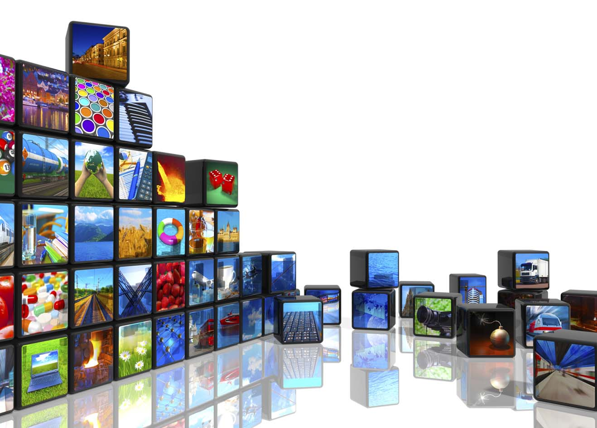
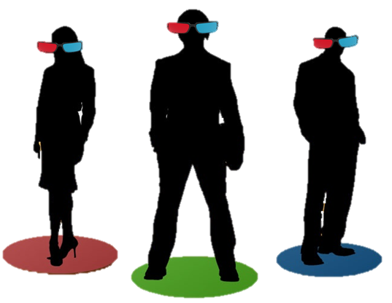
Anaglyph Videos
Student: Jihaad Pienaar
Supervisor: Mr Mehrdad Ghaziasgar
Co-Supervisor: Mr James Connan
Mentors: Mr Roland Foster & Mr Kenzo Abrahams

Slide 2
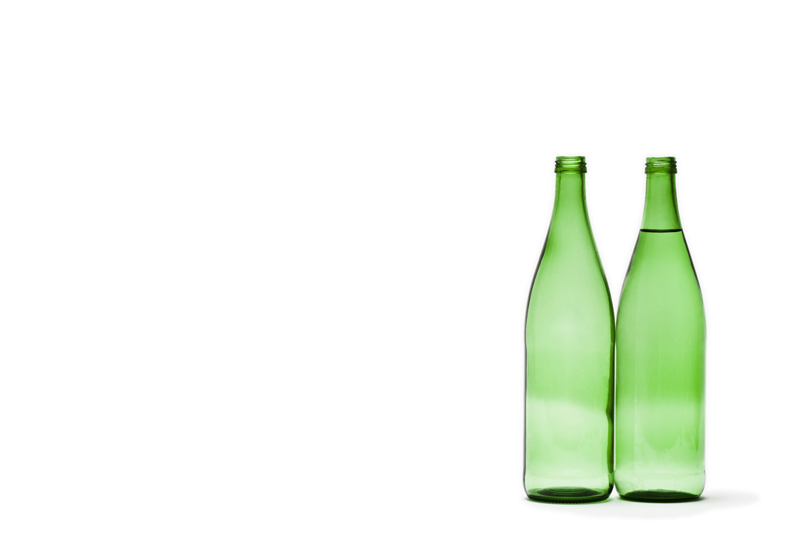
AGENDA
ITEM | SLIDE
A. INTRODUCTION
Project overview | 3.4
Definitions | 5
Requirement Analysis | 6
B. USER INTERFACE SPECIFICATIONS | 7-13
C. IMPLEMENTATION | 14-20
D. TESTING | 21-23
E. DEMO | 24-25
F. REFERENCES | 26

Slide 3
A. INTRODUCTION – PROJECT OVERVIEW
A system which allows users to convert 2D videos into an Anaglyph 3D equivalent.
A. INTRODUCTION

Slide 4
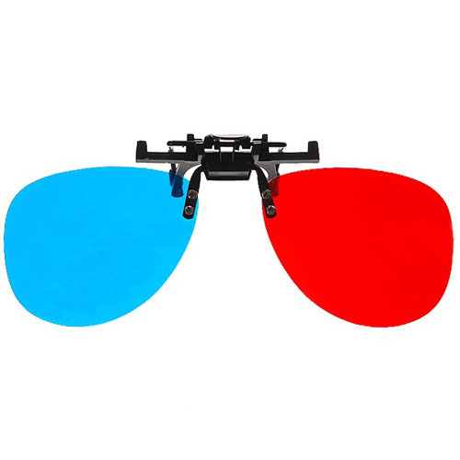

Slide 5
A. INTRODUCTION – DEFINITIONS
Stereo Pair
Contains two views of a scene side by side, ex. The human eye uses stereo pairs, as the left eye produces a left image and the right eye produces a right image.
Stereoscopic 3D
Is the illusion of giving an individual the perception of depth in using what would commonly be seen as traditional two-dimensional visual media.
A. INTRODUCTION
Depth Map
An image or image channel that contains information relating to the distance of the surfaces of scene objects from a viewpoint.

Slide 6
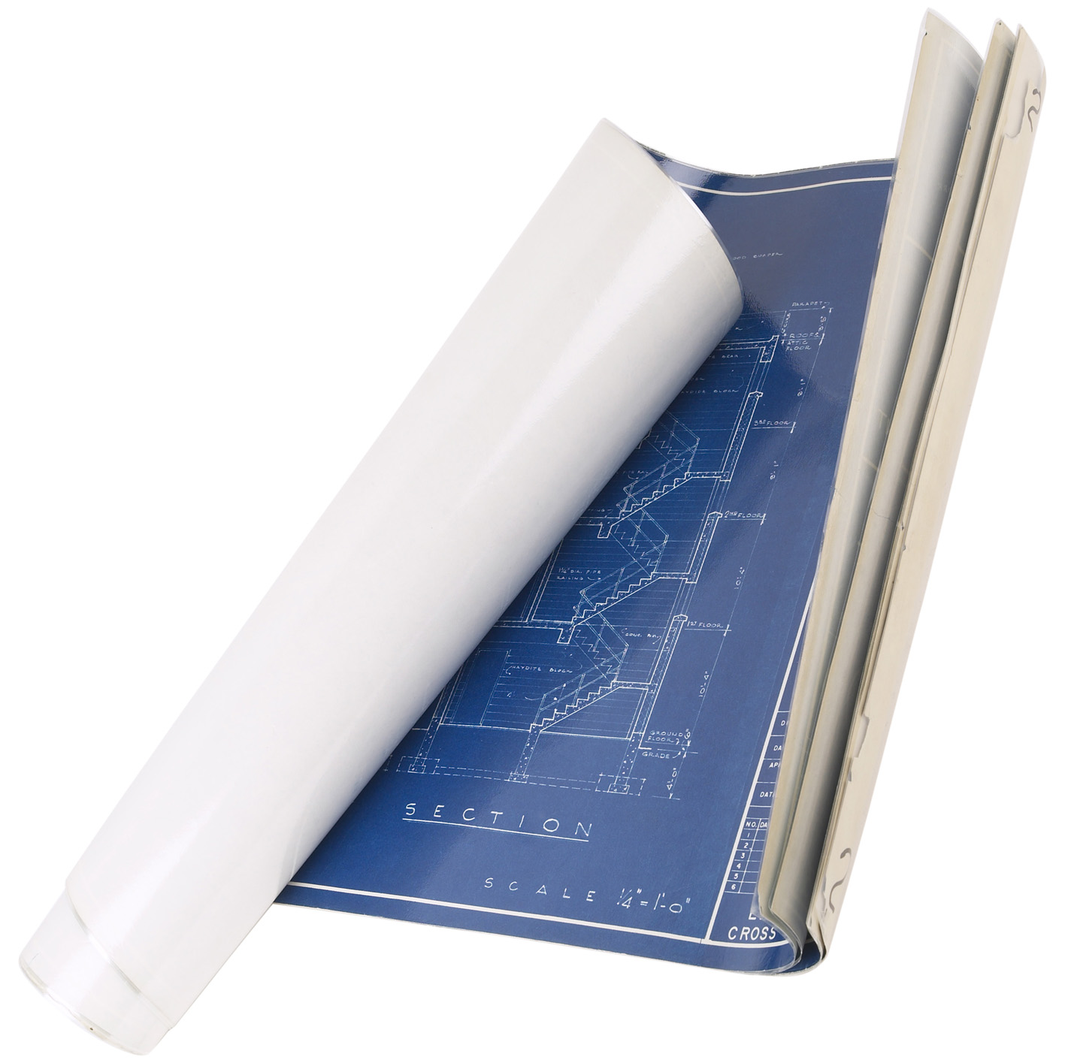
REQUIREMENT ANALYSIS
A. INTRODUCTION
Depth Map
Parallaxing
Stereoscopic pair of images
Conversion
Re-combine
Notes:
achieved through anaglyph 3D and it involves a red and cyan lter applied to
3D glasses. The original video would be split into its individual image , each of
these images would need to be split into a stereoscopic pair, that is, a \left""
and \right"" image.
To achieve the stereoscopic pair of images a depth map would need to be gen-
erated for the original image, with the original image and the depth map a
stereoscopic pair can be generated through a technique called parallaxing. The
colour of the left image would then be converted to red and the colour of the
right image would be converted to cyan. The two images would be displaced by
some amount (depending on the amount of depth we want). Finally we would
re-combine our images to create our 3D anaglyph image. [2] A possible problem
would be ne tuning the Displacement in order to give us the best and most
immersive 3D eect.

Slide 7
B. USER INTERFACE SPECIFICATIONS
Startup
Saving
Playing
Open
Convert
1
2
B. USER INTERFACE
3
4
5

Slide 8
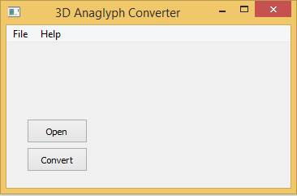
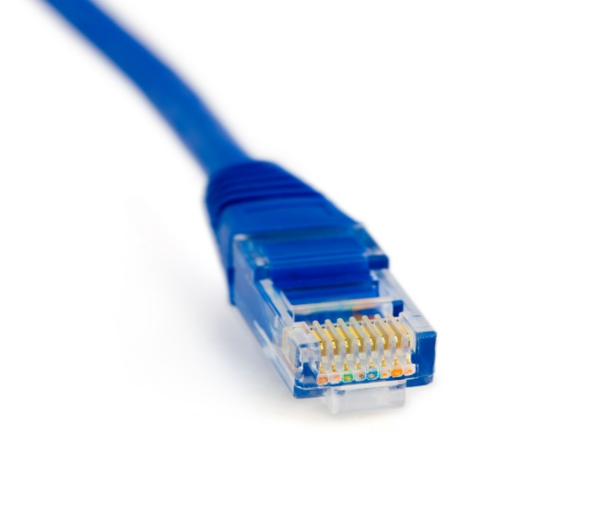
Startup
1
B. USER INTERFACE

Slide 9
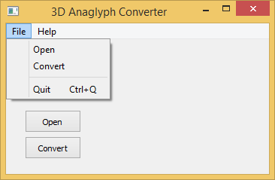
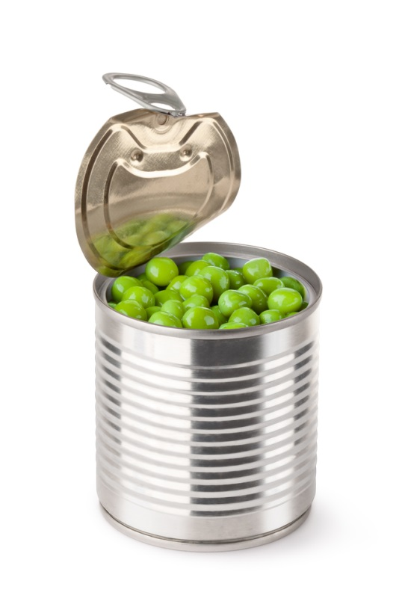
Open
2
B. USER INTERFACE

Slide 10
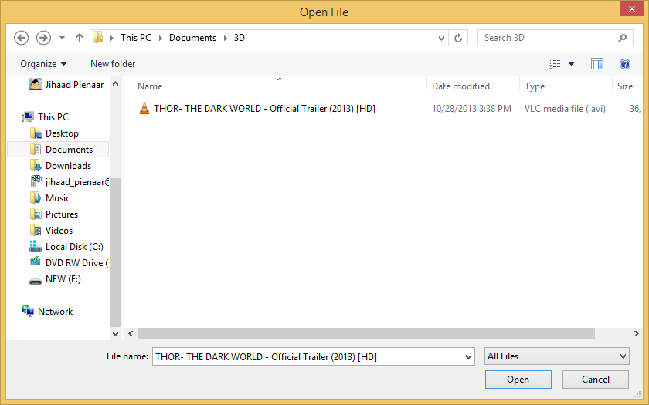
Open
2
B. USER INTERFACE

Slide 11
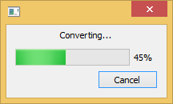
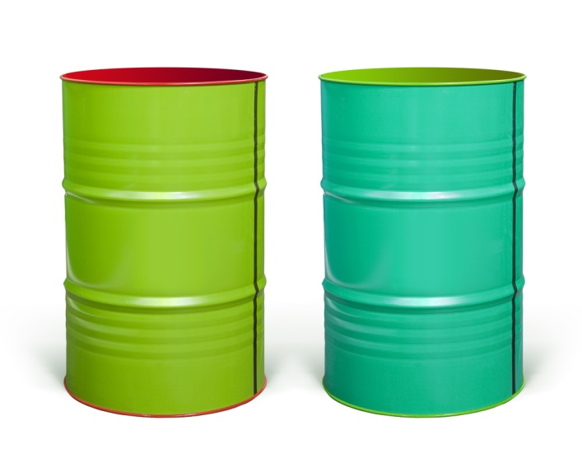
Convert
3
B. USER INTERFACE

Slide 12
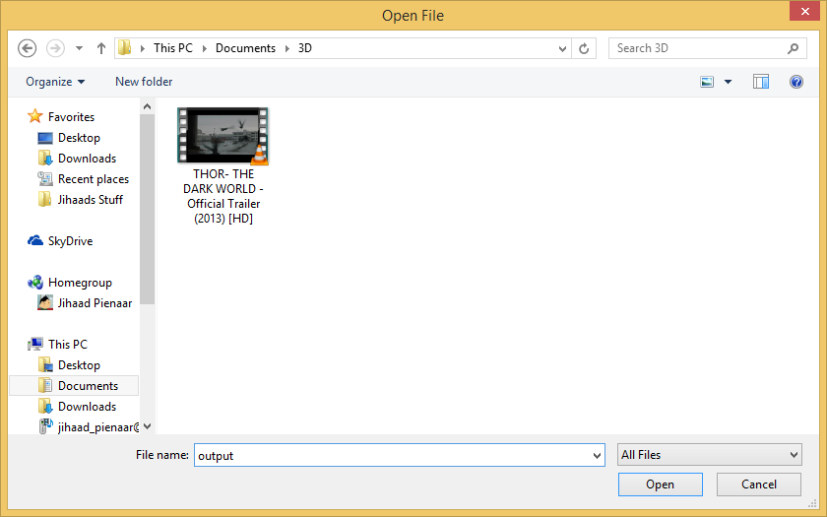

Saving
4
B. USER INTERFACE

Slide 13
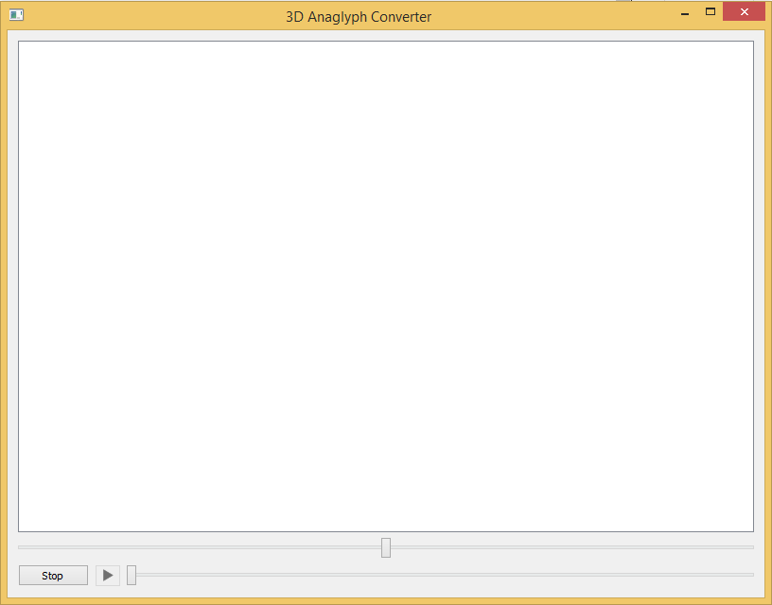
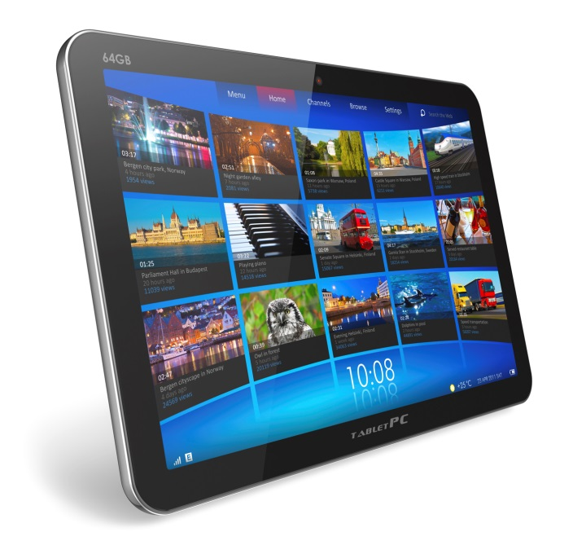
Playing
5
B. USER INTERFACE

Slide 14
C. IMPLEMENTATION
Extract Frames
Dubois
Combine Frames
Foreground Extraction
Parallax Stereo Image Generation
1
2
C. IMPLEMENTATION
3
4
5

Slide 15
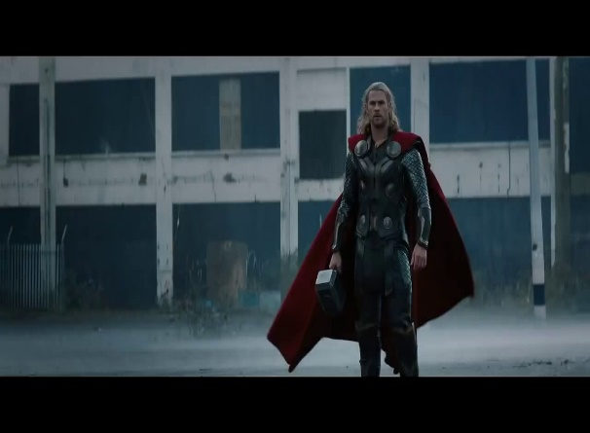
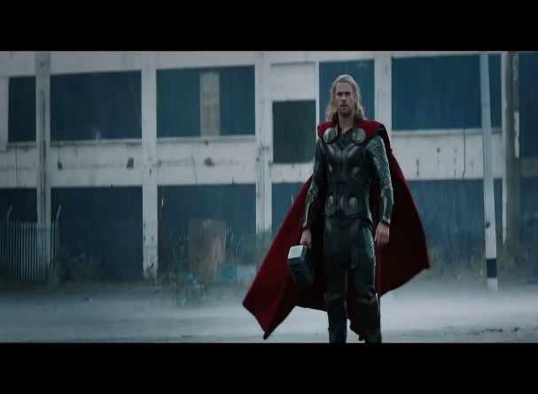
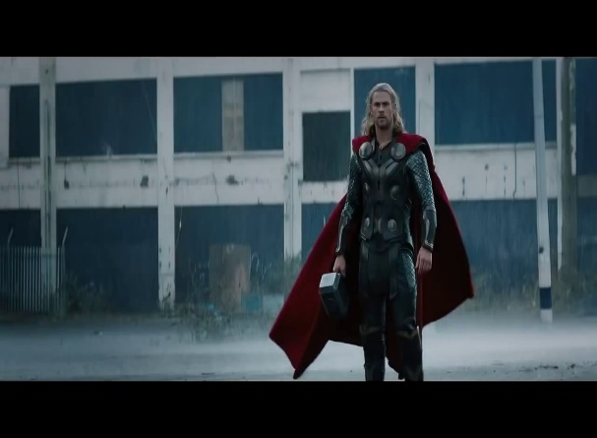
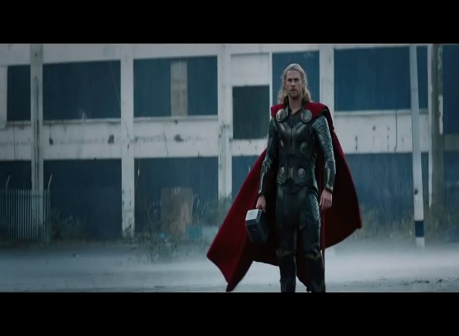
Extract Frames
1
C. IMPLEMENTATION

Slide 16

Foreground Extraction
2
C. IMPLEMENTATION

Slide 17
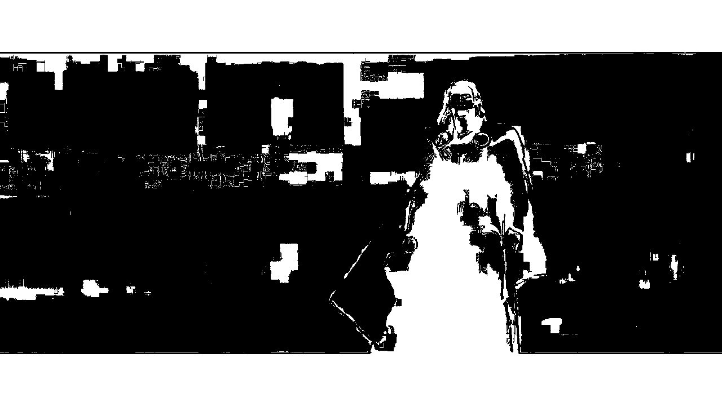
Foreground Extraction
2
C. IMPLEMENTATION

Slide 18

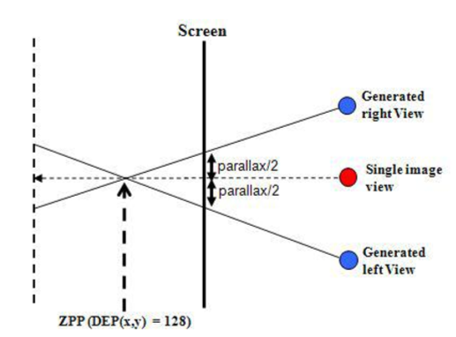
Parallax Stereo Image Generation
3
C. IMPLEMENTATION

Slide 19
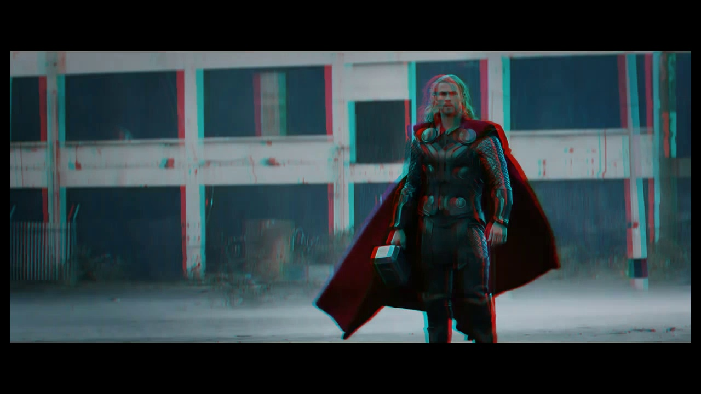
Dubois
4
C. IMPLEMENTATION

Slide 20




Put frames back together to form video
5
C. IMPLEMENTATION

Slide 21
D. TESTING
3D Effect Ratings
Depth Generation
1
2
D. TESTING

Slide 22
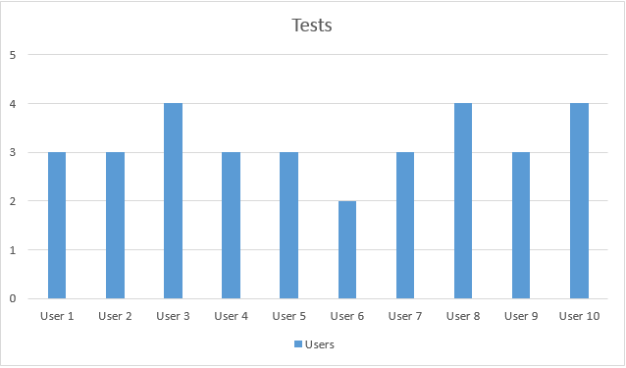
3D Effect Ratings
1
D. TESTING

Slide 23
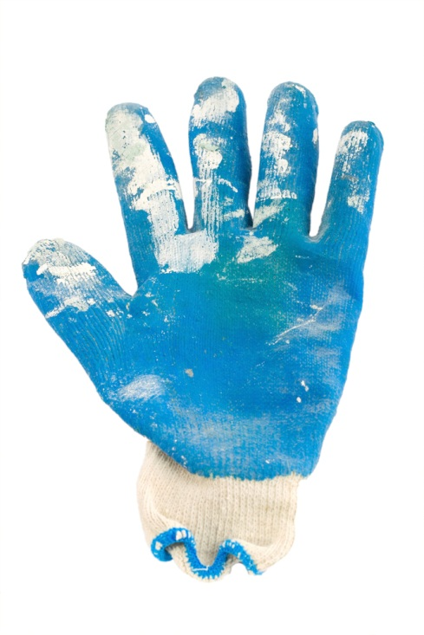
2. DEPTH MAP GENERATION
RECAP – My role
  1786 Frames correct foreground estimation
  Manually inspecting each frame
D. TESTING
  Acceptable
  2320 Frames in total
  About 77%

Slide 24


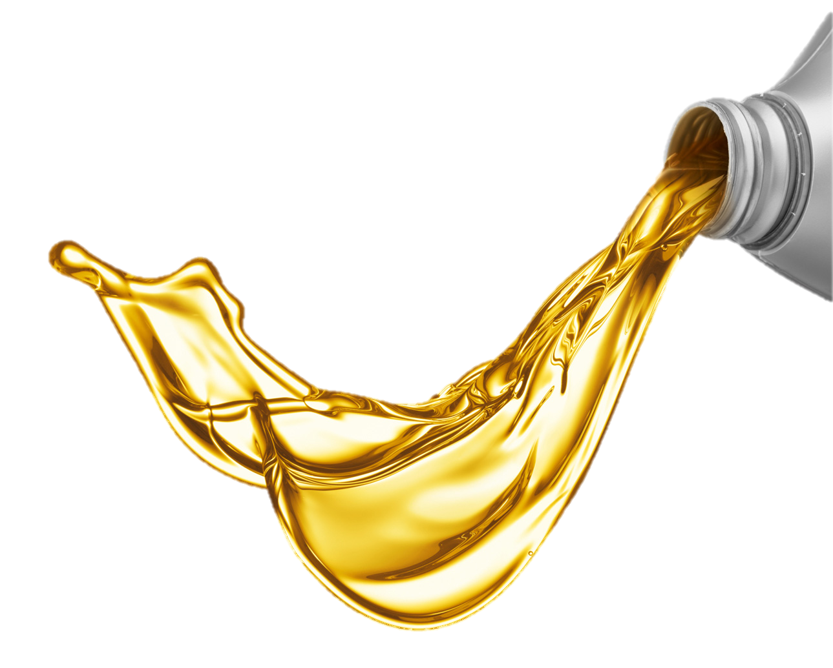


DEMO

Slide 25
Video

Slide 26
F. REFERENCE
Bradski, G., & Kaehler, A., 2008. “Learning OpenCV. United States of America: O’Reilly Media, Inc.”, pp. 8-30
Changick, K., Jungwoo, P., Jaeho, L. & Jenq-Neng, H., 2007. Fast Extraction of Objects of Interest from Images with Low Depth of Field. ETRI, 29(3), pp. 353-363.
Jaeseung, K., Manbae, K. & Changick, K., 2007. 2D-To-3D Stereoscopic Conversion: Depth-Map Estimation in a 2D Single-View Image. Applications of Digital Image Processing XXX, pp. 1-9.

Slide 27

Questions?

