Slide 1
FM Transmitter for Raspberry Pi on Secure Unix Systems BY Kyle Martin
Supervisor:
Dr Jean-Baka Domelevo Entfellner
Mentor:
Mogammat Waleed Deaney

Slide 2
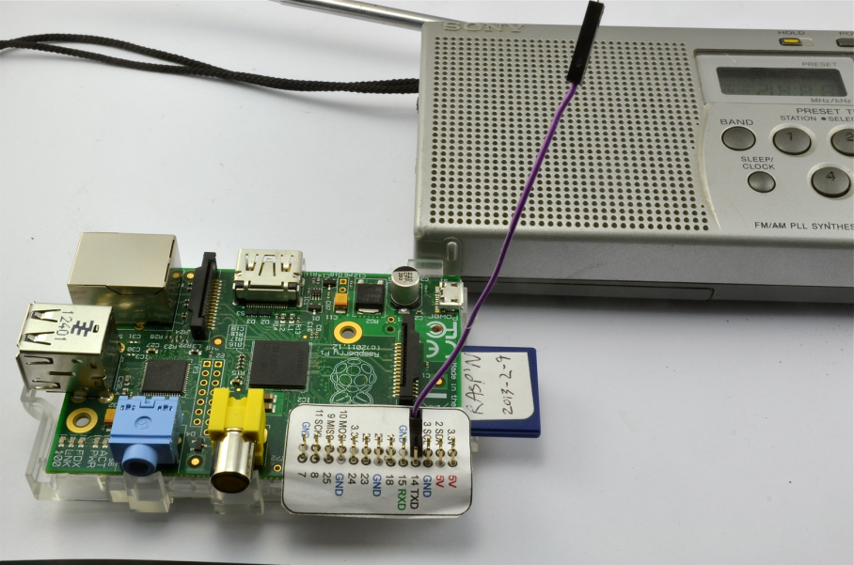
A quick recap

Slide 3
User Interface Specification

Slide 4
User Interface Specification

Slide 5
High Level Design
The core feature of a secure operating system is to protect the hardware.
Manipulation of hardware should never come from userspace.
A user communicates with the operating system. The operating system will then communicate with the hardware.

Slide 6
Low Level Design
Problems:
open(/dev/mem)
PROT_READ &
PROT_WRITE
mmap()
Hex address 0x20000000

Slide 7
Low Level Design
This requires writing device drivers for secure Unix systems that will reduce CPU overhead by managing the DMA and PWM of the Raspberry Pi.

Slide 8
Prototype

Slide 9
Questions?
References:
Christophe Jacquet. (2014). FM-RDS transmitter using the Raspberry Pi's PWM. [Online]
Oliver Mattos and Oskar Weigl. (2015) Turning the Raspberry Pi Into an FM Transmitter. [Online]
L. Yu, S. R. Schach, K. Chen, G. Z. Heller, & J. Offutt (2006) Maintainability of the kernels of open-source operating systems: A comparison of Linux with FreeBSD, NetBSD, and OpenBSD. Journal of Systems and Software.

