Slide 1
BACK-END FOR MONITORING MESH NETWORK
Ajayi Olabode Oluwaseun Department of Computer Science University of the Western Cape, Private Bag x17, Bellville 7535 South Africa Tel: +27 791024568, Fax: +27 21 959 1274 email: boraton2010@gmail.com
Project Supervisor:
Prof Bill Tucker
Project Co-Supervisor:
Mr. MJ. Norman
Project Advisor:
Mr. Carlos Rey-Moreno

Slide 2
PROJECT GOALS REMINDER
This project aim at;
Minimize the storage capacity of the mesh potatoes when outputting data information for decision making process
Frequently checking the values and/or mechanisms to compress the data explored before sending it to the database server.

Slide 3
DESIGN OVERVIEW OF THE PROJECT INTEGRATION
FRONTEND APPLICATION
BACKEND SERVER (MONITORING SYS)
ROUTING PROTOCOL
(BATMAN-ADV)
Notes:
A general overview of the project (architecture) of the mesh network monitoring component.

Slide 4
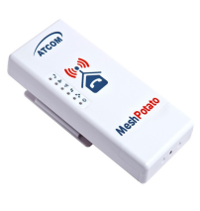
DESIGN INTERACTION BETWEEN PCs AND MESH DEVICE (ADVANCED COMMAND LINE) [1]
1. ssh/telnet to the MP
PCs
6. PCs, can send and received packet.
2. SECN terminal invoke
SECN running the configuration setting
5. SECN aggregate this data into one data structure
3. Query the MP device for its data
Routing Protocol e.g. b.a.t.m.a.n-adv
4. MP devices returned its data for viewing
Notes:
Each MP form a wireless mesh network and they has multi-hop capabilities, and also the ability for self-organize and self heal.
In this our project it is more important to setup the network and determine paths for sending data from one node to the other. Hence, the better approach to mobile ad hoc networks (b.a.t.m.a.n-adv) strategies is to determine for each destination in the mesh one single-hop neighbor, which can be utilized as best gateway to communicate with the destination node. It also help determine the next best hop for each destination. B.a.t.m.a.n-adv operates entirely on ISO/OSI layer 2. It encapsulates and forwards all traffic until it reaches the destination, hence emulating a virtual network switch of all nodes participating

Slide 5
HOW THE B.A.T.M.A.N-ADV ROUTING PROTOCOL WORKS
b.a.t.m.a.n-adv can be use to determine:
The link Quality e.g. batctl o (contains the commands ping, trace route, tcpdump), Node information e.g cat/etc/bat-hosts,
Traffic Performance e.g. athstats, ifconfig
Notes:
better approach to mobile ad hoc networks (b.a.t.m.a.n-adv)

Slide 6
HIGH LEVEL DESIGN
DATABASE FOR THE MESH NETWORK9+
The database structure is stored in MeshBoard.sql. The database tables created are “Network” and “Node” [5].
Notes:
The network table contains information about all the network accounts stored on the front-end pc which serves as a server. The node table contains information about every node for every network on the server.

Slide 7
LOGICAL ARCHITECTURE VIEW OF THE DATABASE SETUP FOR THE MONITORING
The database design structure uses the view-processor logical architecture [5]
Database Server:
‘Network’
‘Node’
Net-setting
Nodes-Infos
Notes:
High level Design Database:
The database server is made u script that take data from the dashboard and present it to the front-end application, as well as script that take user or node input, process it, and update the database.
View Tasks:
query the database for network information to display
Provide forms for the user to input changes to configuration settings
Visualize data and relationships between data in the database.
Processor Tasks:
Receive HTTP requests from the nodes containing network status information and write that information to the view
Generate responses to those HTTP requests based on network configuration settings in the view
Receive network configuration data as form input from the view components and wrute the data to the database.

Slide 8
LOW LEVEL DESIGN e.g.
Configuring Mesh Node Interfaces
The following Steps help to configure each Mesh Nodes:
Use MP Wi-Fi devices like athX and also common ethernet devices, usually ethX. Note X can be 0 and 1
Mesh Node interfaces added using 'batctl if add ifname', e.g. batctl if add eth0
batman-adv identify the interfaces it will use to build the mesh network.

Slide 9
LOW LEVEL DESIGN e.g.
Classes and communication [4].
Parameters to tweak when measuring performance of the current network:
ssh into the MP
Move through the batman-adv kernel directory and its subdirectory
‘cat’ the file to view information e.g hop-penalty setup
‘vim’ the file to change default values

Slide 10
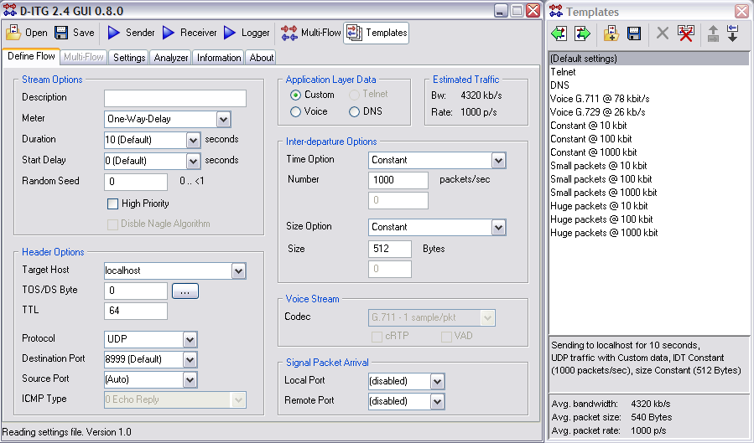
PLATFORM INDEPENDENT TRAFFIC GENERATORS
D-ITG allows generation of network traﬃc [2]:
Notes:
D-ITG allows generation of network traﬃc (ICMP), transport layer traﬃc (TCP and UDP) and several “layer 5-7” traﬃc (HTTP, FTP, TELNET, SMTP, DNS, VOIP, Video, NNTP, etc.).

Slide 11
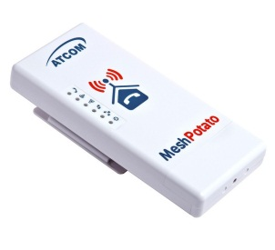
MESH POTATO SETUP DESIGN
Mesh Potato
MP_Station1
Mesh Potato
MP_Station2
IP Wlan0: 10.10.1.20/24
IP eth0: 10.130.1.50
IP Wlan0: 10.10.1.21/24
IP eth0: 10.130.1.51
IP eth0: 10.130.1.7/24
Net mask: 255.255.255.0
IP eth0: 10.130.1.8/24
Net mask : 255.255.255.0
Notes:
This Setup is called Mesh-Mode Infrastructure. This is an important part of the project, as this is where monitoring component was developed on. This design that we constructed consisted of two Mesh Potatoes (MPs) and a frontend application running on the desktop pc. The frontend and the MP formed a wireless ad hoc mesh network amongst themselves.

Slide 12
PROJECT PLAN
Term 2 | First term completed
Term 2 Designing and preparing the prototype. (Completed) | Documentation(Report) System Architecture User interface specification, Creating Mesh Network Setting-up Mesh Nodes, Designing and Configuration the batman-adv routing protocol on MP
Term 3 Implementation and coding | Further research to re-modify Carlos Script for project implementation to log realtime Network Activity. Capturing Signal received from neighbors. Setting gateway bandwidth for Uplink and downlink Speed of the gateway. Setting the Queue Discipline for the Mesh Nodes. Working with the department Mesh Node for easy Integration. E.g. VOIP, and Internet Usage.
Term 4 Testing and Evaluation | Ability to test the application Remotely Qualitative evaluating Method of testing the App.

Slide 13
REFERENCES
[1] Gillett, T. Mesh Potato Small Enterprise/ Campus Networks. 2011, page 17.
[2] Avallone, S. et al., 2004. D-ITG Distributed Internet Trafﬁc Generator. s.l., IEEE Computer society.
[3] Learning b.a.t.m.a.n-adv, http://www.open-mesh.org/projects/batman-adv/wiki
Accessed 01 March 2013
[4] batctl commands, http://downloads.openmesh.org/batman/manpages/batctl.8.html.
Access on 24 May 2013
[5] Badonnel, R., State, R. and Festor, O. (2005), Management of mobile ad hoc networks: information model and probe-based architecture. Int. J. Network Mgmt., 15: 335–347. doi: 10.1002/nem.577

Slide 14
PROTOTYPE DEMO
Testing quality of service
Using the D-ITG to generate traffic and send to mesh networks

Slide 15
CONCLUSION

