Slide 1
LIGHTWEIGHT CLOUD COMPUTING FOR FAULT-TOLERANT DATA STORAGE MANAGEMENT
by
Prince Steve Kamanke
Supervisor : Antoine Bagula Mentor : Samson Akintoye

Slide 2
Overview
Introduction
Users Requirement Document
The Lightweight Cloud Model
Requirement Analysis Document
Project Plan
References

Slide 3
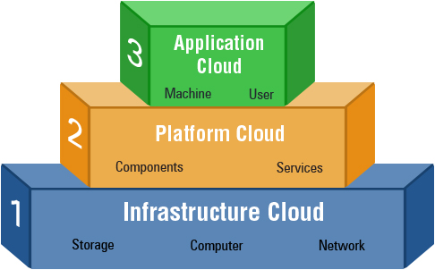
Introduction
What is Cloud Computing ?
Definition
Service Models
Benefits
Notes:
NIST Definition : A model for enabling ubiquitous, convenient, on-demand network access to a shared pool of configurable computing resources (e.g., networks, servers, storage, applications, and services) that can be rapidly provisioned and released with minimal management effort or service provider interaction.
Application Cloud: PPM Applications, SharePoint, Google Docs, Dropbox , etc. Platform Cloud: IIS Web Server, SQL Server, Active Directory, etc. Infrastructure Cloud: Physical Servers, Storage Systems, Windows Server, etc.
Benefits: * Companies avoid upfront infrastructure costs, and focus on projects that differentiate their businesses instead of on infrastructure * Cloud-based services are ideal for businesses with growing or fluctuating bandwidth demands. If your needs increase it’s easy to scale up your cloud capacity, drawing on the service’s remote servers

Slide 4
User Requirement Document
Big Data Challenges
Poor ICT infrastructures
Intermittent power supply grid
The Lightweight Cloud Model
Notes:
Big Data Challenges: While coming on top of the list of the technical architectures that address the “Big Data” challenges, traditional cloud computing infrastructures have not been able to adequately mitigate some of their own shortcomings which include an ever rising Carbon footprint as a direct result of the immense cooling requirements for large data centres, lack of privacy controls, and use of vendor lock-in systems.
Furthermore, while traditional cloud computing is ideal for ICT deployments in developed countries, it does not meet the requirements for deployment in third world countries plagued by poor ICT infrastructures causing intermittent access to and from the cloud limiting service delivery. Another mitigating factor is the unstable nature of electrical grids in these countries which makes CC unreliable at best. All of these points nullifies the whole point of having a Cloud Computing Infrastructure in the first place, which brings me to the essence of my project : The Lightweight Cloud Model.

Slide 5
The Lightweight Cloud Model
LWCM*
Cloud Architecture
Service Delivery
Task Allocation
Notes:
The lightweight cloud model attempts to merge three constrains of known

Slide 6
The Lightweight Cloud Model
Cloud Architecture
Centralized & Distributed
Hybrid Approach
Service Delivery
Task Allocation
Auction-based mechanisms
Notes:
Cloud Architecture
Centralized: Centralized architectures provides optimal resource allocation, they have liabilities resulting to a single point of failure in the cloud infrastructure and performance issues related to the access bandwidth to a unique cloud broker.
Distributed: More scalable solution with sub optimal issues: locally optimized tasks that do not converge into a global optimum.
Hybrid: Although it offers the best way to alleviate both weaknesses of the aforementioned architectures, it’s implementation can be really complex and prone to errors
Service Delivery
An emphasis will also be made on service delivery. Meaning this model will aim speed up data processing within limited storage by eliminating redundancy on the previously mentioned architectures
Task Allocation
Task allocation is another key parameter in a lightweight cloud infrastructure with limited storage and processing power capabilities.

Slide 7
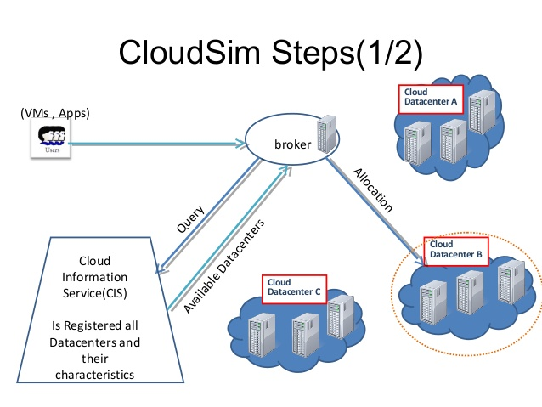
Requirement Analysis Document
Infrastructure Design
Simulation
CloudSim
Experimentation
OpenStack
Comparison
Notes:
The main objective of this project will be to implement this lightweight cloud model by first designing it’s infrastructure.
Infrastructure Design: Mapping of resource allocation models such as Integer Linear Programming, Knapsack, Hungarian methods or the previously heuristics into a Cloud Infrastructure in order to evaluate these models.
Simulation Run a simulation on storage management application that will evaluate the performance of this infrastructure and
Experiment this infrastructure on different replication model using OpenStack
Last set of experiments will be conducted to compare the performance and efficiency of the lightweight cloud infrastructure using different low powered hardwares such as raspberry pis, or dual core computers to implement a fault tolerant storage system.

Slide 8
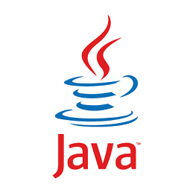
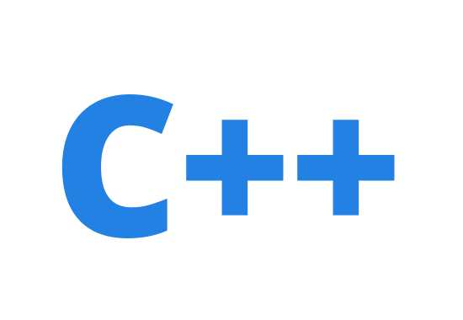
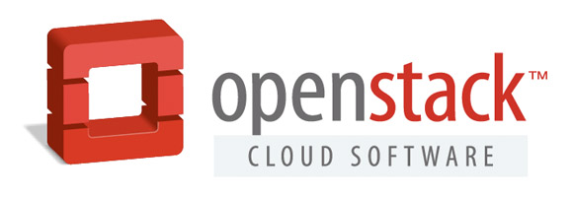
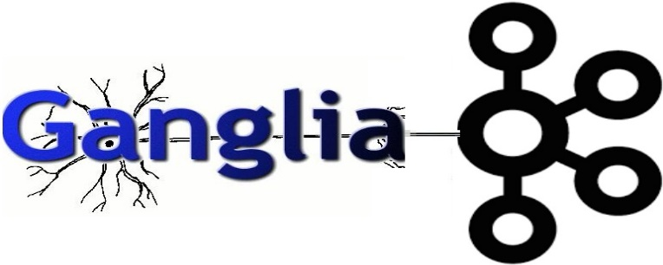
Tools

Slide 9
Project Plan
TERM 1 | Information gathering, Project Analysis
TERM 2 | URD, UIS, Requirement Analysis & Project Design
TERM 3 | Coding, Implementation
TERM 4 | Testing, evaluation, & presentation

Slide 10
References
WHY MOVE TO THE CLOUD ? 10 Benefits of Cloud Computing https://www.salesforce.com/uk/blog/2015/11/why-move-to-the-cloud-10-benefits-of-cloud-computing.html
Bagula, A. (2016). Lightweight Cloud Computing for Fault-tolerant Data Storage Management. Cape Town: ISAT Laboratory, UWC Department of Computer Science.
Zhao, W., Melliar-Smith, P., & Moser, L. (2010). Fault Tolerance Middleware for Cloud Computing. IEEE 3rd International Conference on Cloud Computing. Miami, FL: IEEE Computer Society.
Mell, P., & Grance, T. (2011). The NIST Definition of Cloud Computing. The National Institute of Standards and Technology.
Mullins, T. (2014). Participatory Cloud Computing: The Community Cloud Management Protocol. South Africa: ISAT Laboratory, University of Cape Town.

Slide 11
THE END

