Slide 1
LIGHTWEIGHT CLOUD COMPUTING FOR
FAULT-TOLERANT DATA STORAGE MANAGEMENT
by
Prince Steve Kamanke
Supervisor : Antoine Bagula
Mentor : Samson Akintoye

Slide 2
Brief Recap
  Goals & Objectives
  The Simulation Model : CloudSim

Slide 3
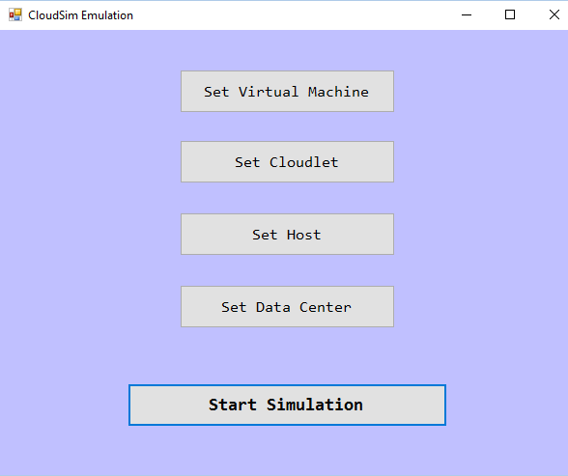
User Interface Specification
  Login optional but not compulsory
  Purely for initialization purposes
  Cloud user can set different component according to simulation requirements
  Default parameters will be allowed for trivial scenarios

Slide 4
High Level Design (Simplified)

Slide 5
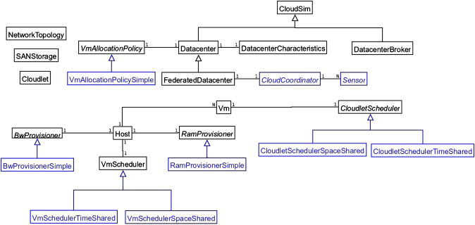
High Level Design (Detailed)
Notes:
CloudletScheduler: This abstract class is extended by the implementation of different policies
that determine the share of processing power among Cloudlets in a VM. As described previously,
two types of provisioning policies are offered: space-shared (CloudetSchedulerSpaceShared) and
time-shared (CloudletSchedulerTimeShared).
VmmAllocationPolicy: This abstract class represents a provisioning policy that a VM Monitor
utilizes for allocating VMs to hosts. The chief functionality of the VmmAllocationPolicy is to select
the available host in a data center that meets the memory, storage, and availability requirement for
a VM deployment.
VmScheduler: This is an abstract class implemented by a Host component that models the policies
(space-shared, time-shared) required for allocating processor cores to VMs. The functionalities of
this class can easily be overridden to accommodate application-specific processor sharing policies.

Slide 6
Low Level Design
  Instantiation & Initialization
  Create a data centre which provides resources to the simulation and the hosts as well
  Create a broker accountable for submission of Virtual Machines and Cloudlets on behalf of a given cloud user
  Create one or many virtual machines and cloudlets according to user specifications
  Have the broker bind cloudlet to virtual machine using an allocation policy
  Start simulation

Slide 7
Project Plan
TERM 1 | Information gathering, Project Analysis
TERM 2 | URD, UIS, Requirement Analysis & Project Design
TERM 3 | Coding, Implementation
TERM 4 | Testing, evaluation, & presentation

Slide 8
References
WHY MOVE TO THE CLOUD ? 10 Benefits of Cloud Computing
https://www.salesforce.com/uk/blog/2015/11/why-move-to-the-cloud-10-benefits-of-cloud-computing.html
Bagula, A. (2016). Lightweight Cloud Computing for Fault-tolerant Data Storage Management. Cape Town: ISAT Laboratory, UWC Department of Computer Science.
Zhao, W., Melliar-Smith, P., & Moser, L. (2010). Fault Tolerance Middleware for Cloud Computing. IEEE 3rd International Conference on Cloud Computing. Miami, FL: IEEE Computer Society.
Mell, P., & Grance, T. (2011). The NIST Definition of Cloud Computing. The National Institute of Standards and Technology.
Mullins, T. (2014). Participatory Cloud Computing: The Community Cloud Management Protocol. South Africa: ISAT Laboratory, University of Cape Town.
Buyya, R., Beloglazov, A., Calheiros, R. N., Ranjan, R., & Rose, C. A. (2009, November 3). CloudSim: a toolkit for modeling and simulation of cloud computing environments and evaluation of resource provisioning algorithms. SOFTWARE – PRACTICE AND EXPERIENCE, 41:23-50.

Slide 9

Demo | Q&A

