Slide 1
LIGHTWEIGHT CLOUD COMPUTING FOR FAULT-TOLERANT DATA STORAGE MANAGEMENT
by
Prince Steve Kamanke
Supervisor : Antoine Bagula Mentor : Samson Akintoye

Slide 2
Brief Recap
Goals & Objectives
Implement an optimal Cloud Computing model for fault tolerant infrastructures.
Dynamic resource mapping allocation to evaluate this model.
Building upon the CloudSim Framework
Define allocation, scheduling, and brokering policies.

Slide 3
Overview
Design Decisions and System Changes
Updated Interface
Implementation
Tools Used
Project Plan

Slide 4
Design Decisions and System Changes
PREVIOUSLY | CURRENTLY
No interface, purely command line | Working Interface
No VM Allocation Policy | Dynamic workload
No Scheduling Policy | Time or Spaced Shared
One to one resource mapping | Scalable Simulation scenarios
Notes:
VmmAllocationPolicy: This abstract class represents a provisioning policy that a VM Monitor
utilizes for allocating VMs to hosts. The chief functionality of the VmmAllocationPolicy is to select
the available host in a data center that meets the memory, storage, and availability requirement for
a VM deployment.

Slide 5
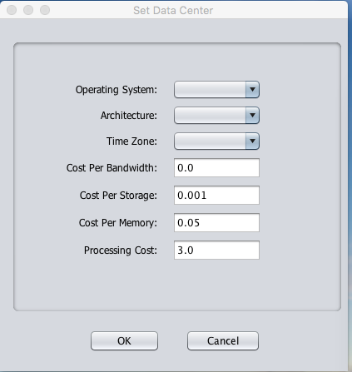
User Interface
Notes:
The application simulates an Infrastructure as a Service (IaaS) provider with an arbitrary number of datacenters. Each datacenter is entirely customizable. The user can easily set the amount of computational nodes (hosts) and their resource configuration, which includes processing capacity, amount of RAM, available bandwidth, power consumption and scheduling algorithms. The customers of the IaaS provider are also simulated and entirely customizable. The user can set the number of virtual machines each customer owns, a broker responsible for allocating these virtual machines and resource consumption algorithms. Each virtual machine has its own configuration that consists of its hypervisor, image size, scheduling algorithms for tasks (here known as cloudlets) and required processing capacity, RAM and bandwidth.

Slide 6
Sample Log output

Slide 7
Simulation Flow
Create Hosts & Datacenters
Create VMs & Cloudlets
Submit VMs and Cloudlets through Broker Agent
Bind them through Allocation & Scheduling Policy
Start Simulation and generate report

Slide 8
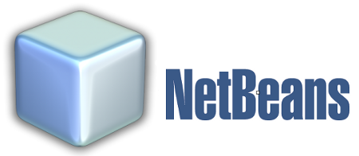
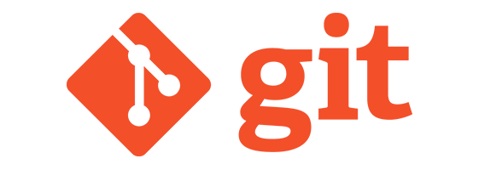
Tools Used

Slide 9
Project Plan
TERM 1
Information gathering, Project Analysis
TERM 2
TERM 3
Creating the interface, Implementing High & Low level designs.
TERM 4
Improve & update the interface.
URD, UIS, Requirement Analysis & Project Design
Run minimal simulation via command line
Run dynamic & scalable simulation through the interface
Introduce brokering policies & generate HTML reports

Slide 10
References
WHY MOVE TO THE CLOUD ? 10 Benefits of Cloud Computing https://www.salesforce.com/uk/blog/2015/11/why-move-to-the-cloud-10-benefits-of-cloud-computing.html
Bagula, A. (2016). Lightweight Cloud Computing for Fault-tolerant Data Storage Management. Cape Town: ISAT Laboratory, UWC Department of Computer Science.
Zhao, W., Melliar-Smith, P., & Moser, L. (2010). Fault Tolerance Middleware for Cloud Computing. IEEE 3rd International Conference on Cloud Computing. Miami, FL: IEEE Computer Society.
Mell, P., & Grance, T. (2011). The NIST Definition of Cloud Computing. The National Institute of Standards and Technology.
Mullins, T. (2014). Participatory Cloud Computing: The Community Cloud Management Protocol. South Africa: ISAT Laboratory, University of Cape Town.
Buyya, R., Beloglazov, A., Calheiros, R. N., Ranjan, R., & Rose, C. A. (2009, November 3). CloudSim: a toolkit for modeling and simulation of cloud computing environments and evaluation of resource provisioning algorithms. SOFTWARE – PRACTICE AND EXPERIENCE, 41:23-50.

Slide 11
Demo | Q&A

Slide 12
End
THANK YOU !

