Slide 1
LIGHTWEIGHT CLOUD COMPUTING FOR FAULT-TOLERANT DATA STORAGE MANAGEMENT
by
Prince Steve Kamanke
Supervisor : Antoine Bagula Mentor : Samson Akintoye

Slide 2
Quick Recap
Problem Definition
The need for a light weight cloud computing model
Goals & Objectives
Develop a user interface that enables experimental simulation that would otherwise be tedious and time consuming to do over real infrastructures when running multiple test runs
Why CloudSim ?
It implements generic application provisioning techniques that can be extended with ease and limited effort

Slide 3
Overview
Introduction
User Interface
Implementation
Testing
Conclusion
Demo

Slide 4
Introduction
The importance of Cloud Computing
The Problem with using real infrastructures such as Amazon EC2 and Microsoft Azure for benchmarking
Hypothesis evaluation through Simulation
The LWCC Graphical User Interface

Slide 5
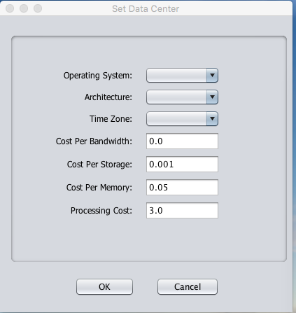
User Interface
Platform Independent
Runs entirely in Java
Enables initial performance testing
Notes:
VmmAllocationPolicy: This abstract class represents a provisioning policy that a VM Monitor
utilizes for allocating VMs to hosts. The chief functionality of the VmmAllocationPolicy is to select
the available host in a data center that meets the memory, storage, and availability requirement for
a VM deployment.

Slide 6
Simulation Flow
Create Hosts & Datacenters
Create VMs & Cloudlets
Submit VMs and Cloudlets through Broker Agent
Bind them through Allocation & Scheduling Policy
Start Simulation and generate report

Slide 7
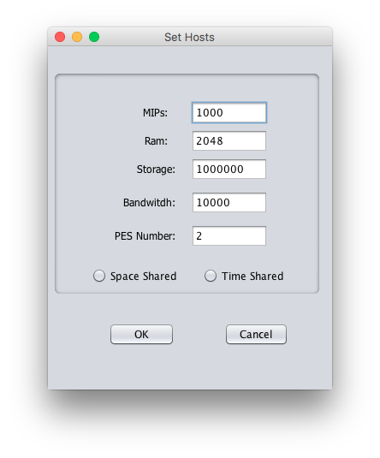
User Interface
Introduction of 2 new scheduling policies: Time-Shared & Space-Shared

Slide 8
Testing
Host Machine:
CPU cores: 2 | Bandwidth Capacity : 10mbps Storage Capacity : 1TB | Ram : 2GB | MIPS : 1000
Virtual Machines:
Storage Capacity : 10GB | Bandwidth : 1GB Ram : 512MB
Cloudlets:
Length : 10GB File size : 300MB Output size : 300MB

Slide 9
Testing
3 simulation scenarios carried
Scenario 1:
One Data center running one host, one virtual machine, one cloudlet (Trivial)
Scenario 2:
One Data center running one host, in which the number of Virtual Machine is a function of the number of CPU cores present in the host. The VMs uses a Time-Shared scheduling policy.
Scenario 3:
One Data center running one host, in which the number of Virtual Machine is a function of the number of CPU cores present in the host. The VMs uses a Spaced-Shared scheduling policy.

Slide 10
Outcome
Scenario 1:
VM & Cloudlet binds flawlessly.
Execution time : 10 milliseconds
Scenario 2:
One cloudlet will be present in each Virtual Machine and they will both use all VM cores and MIPS (Millis Instructions Per Seconds) capacities. However, since each host’s CPU will be shared between 2 virtual machines that are using time-shared scheduling policy, the cloudlet will take twice the time to complete execution.
Execution time : 20 milliseconds
Scenario 3:
Broker fails in allocating a host for the last 2 virtual machines because the first two have already consumed all MIPS available. Once each of the 2 host Pes has a capacity of 1000 MIPS, defining that each one of the 4 virtual machines require 500 MIPs, the allocation the last 2 VMs fails.
Execution time : 20 milliseconds (with 2 destroyed VMs and unattended cloudlets)

Slide 11
Conclusion
A lot of for flexibility
Application has endless possibility in an experimental context
User can design scheduling and allocation policies tailored to his needs.
Though in it’s very early stages, the LWCC Gui is one of the very few Cloud Sim user interfaces out there.
Room for improvement

Slide 12
Tools Used

Slide 13
References
WHY MOVE TO THE CLOUD ? 10 Benefits of Cloud Computing https://www.salesforce.com/uk/blog/2015/11/why-move-to-the-cloud-10-benefits-of-cloud-computing.html
Bagula, A. (2016). Lightweight Cloud Computing for Fault-tolerant Data Storage Management. Cape Town: ISAT Laboratory, UWC Department of Computer Science.
Zhao, W., Melliar-Smith, P., & Moser, L. (2010). Fault Tolerance Middleware for Cloud Computing. IEEE 3rd International Conference on Cloud Computing. Miami, FL: IEEE Computer Society.
Mell, P., & Grance, T. (2011). The NIST Definition of Cloud Computing. The National Institute of Standards and Technology.
Mullins, T. (2014). Participatory Cloud Computing: The Community Cloud Management Protocol. South Africa: ISAT Laboratory, University of Cape Town.
Buyya, R., Beloglazov, A., Calheiros, R. N., Ranjan, R., & Rose, C. A. (2009, November 3). CloudSim: a toolkit for modeling and simulation of cloud computing environments and evaluation of resource provisioning algorithms. SOFTWARE – PRACTICE AND EXPERIENCE, 41:23-50.

Slide 14
Demo | Q&A

Slide 15
End
THANK YOU !

