Slide 1
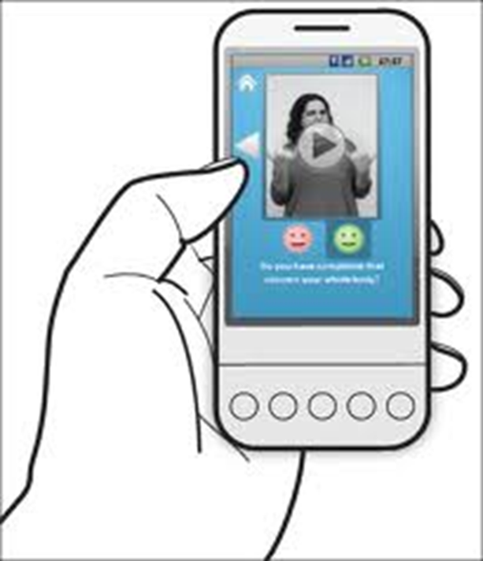
Mobile Medical Information for the Deaf
Siphokazi Dayile
Supervisor: Prof I Venter
Co-supervisor: Prof WD Tucker

Slide 2
Overview
Quick Recap
System testing
-Usability testing
- Functionality testing
Demo
Questions

Slide 3
Quick Recap
What is Mobile Medical Information for the Deaf
It is an application that will help Deaf people gain access to information about illnesses using their android devices.
The project aimed to provide the information in SASL.
The information will be recorded and will then be translated into sign language using video footage.

Slide 4
User Requirements
The requirements were gathered using the literature review and interviews.
Require a system that will help them gain access to illness information in a language that they understand which is SASL.
The system must be reliable and easy to use.

Slide 5
System Implementation

Slide 6
Tools used
Eclipse IDE for Java developers.
Development Kit(JDK) and Java Runtime Environment (JRE).
Android Developer Tool
- Android SDK
- Android Real device(ARD)
- Android Virtual Device(AVD)

Slide 7
System testing
Users that were identified to test the system
-UWC students.
Users were given instructions on how the application works.
One device was used for testing since there were a few number of participants.
The system testing focused on two testing
-Usability testing
-Functionality testing.

Slide 8
Usability testing
The usability testing mainly focused on the appearance and how user friendly the system is.
Participants were given a walkthrough on the application.
They were then asked to complete a questionnaire to find out what they thought about the application.
Participants were then asked to rate how easy it was using the application.
The look and feel of the application.

Slide 9
Testing results
How would you rate the usability of the application

Slide 10
Functionality testing
The functionality testing focused on whether or not the application is doing what it is required to do.
Participants were asked to say whether or not the users requirements were met.

Slide 11
Functionality testing

Slide 12
Feedback
Participants gave positive feedback on the application.

Slide 13
Demo
User selects an illness.
View illness information.
Moving from one screen to the other.

Slide 14
Questions

