Slide 1
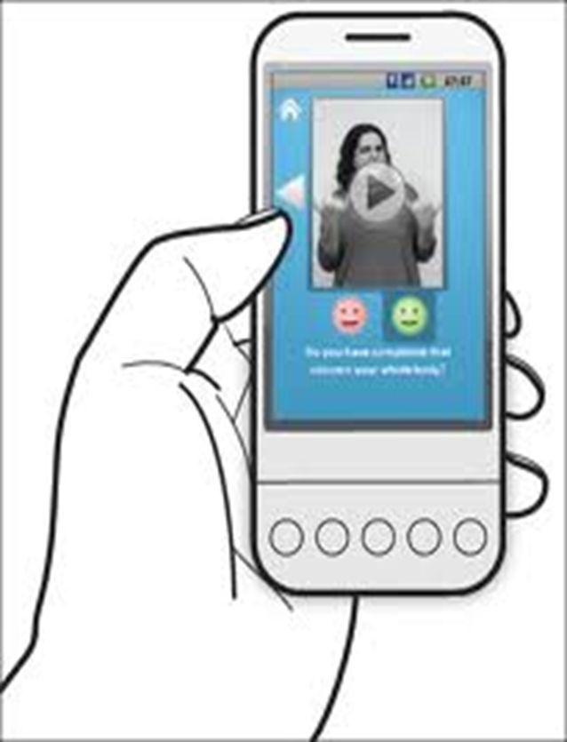
Mobile Medical information for the Deaf
By: Siphokazi Dayile
Supervisor: Prof I Venter
Co-supervisor: Prof WD Tucker

Slide 2
Overview
Introduction
Implementation
User interface changes
Challenges
Progress
Tools
Future Work
Project Plan
References

Slide 3
Introduction
Provide the Deaf people with illness information
Use pre-recorded videos

Slide 4
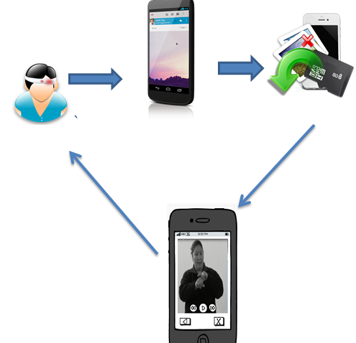
Implementation

Slide 5
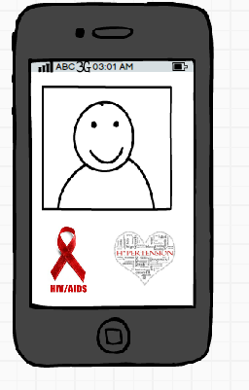
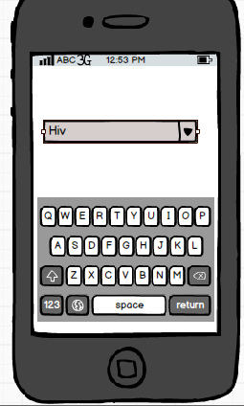
User interface Changes

Slide 6
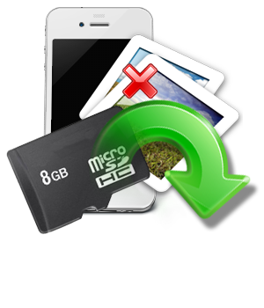
User Interface Changes
Database
SD card

Slide 7
Challenges
Creating video thumbnail
Getting the video’s from the SD card to play using eclipse

Slide 8
Progress
Allow a user to choose an illness from the list of illnesses provided
Displaying Video from the SD card
Users navigate between screens
Providing the information in sign language

Slide 9
Future Work
Creating video thumbnails
Allow a user to select an illness using a scrollable list
Navigate between screens using page parser

Slide 10
Tools
Eclipse IDE for Java developers
Development Kit(jdk) and Java Runtime Environment (JRE)
Android Developer Tool
- Android SDK
- Android Real device(ARD)
- Android Virtual Device(AVD)

Slide 11
Project plan
Term | Goal | Finishing
1 | Requirements and analysis | 2nd April
2 | Design and Development | End of term 2
3 | Implementation Interface changes Research Programming | End of term 3
4 | Test and Debug Usability testing Performance testing Acceptance test | End of term 4

Slide 12
References
Bhecker. (2013, 09 09). bhecker. Retrieved from ITU Classes: http://www.bhecker.com/itu/viewforum.php?f=153
Developers, A. (2013, Feb). Developers. Retrieved from Android developers: http://developer.android.com
MD, D. (2013). Deaf MD. Retrieved from Health Education in American Sign Language: http://www.deafmd.org

Slide 13
Demo
User select an illness
View illness information
Moving from one screen to the other

Slide 14
Questions

