Slide 1
AHED Automatic Human Emotion Detection

Slide 2
Hello!
I am Retshidisitswe Lehata
Supervisor:
Mehrdad Ghaziasgar
Co-Supervisor:
Reg Dodds

Slide 3
Overview
Recap of Proposed System
User Interface
High-Level Design
Low-Level Design
Project Plan
References

Slide 4
Recap of Proposed System
Automatically recognize human emotions
Using facial expressions
From canned videos
Detecting the dominant emotion

Slide 5
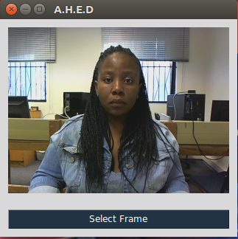
User Interface
Live video stream
Button to visualize feature extraction for a selected frame

Slide 6
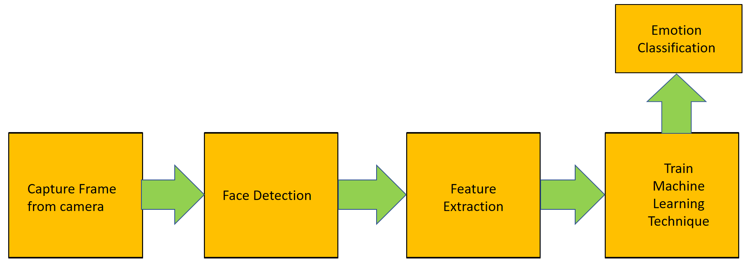
High-Level Design

Slide 7
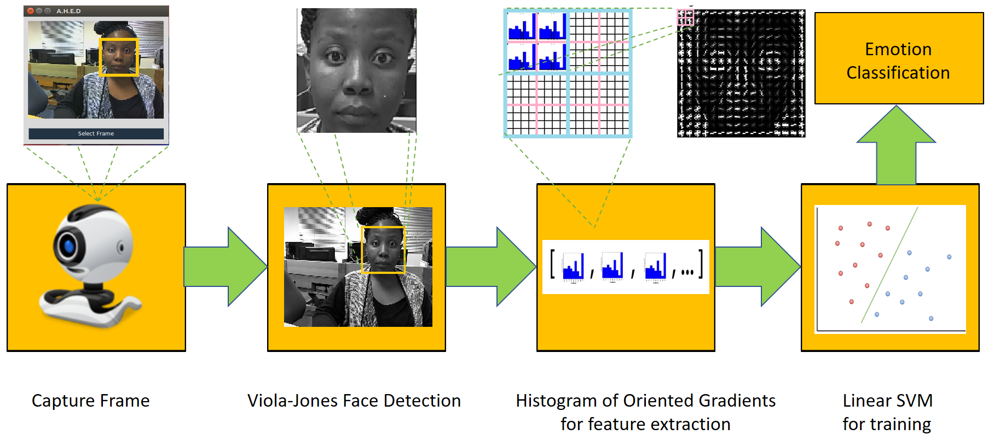
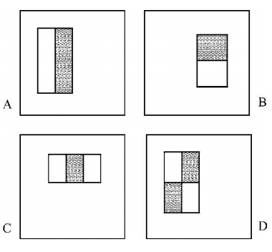
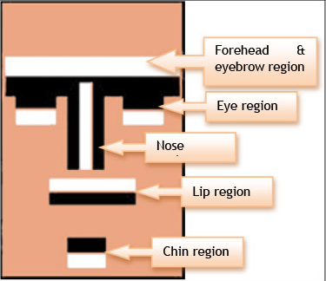
Low-Level Design

Slide 8
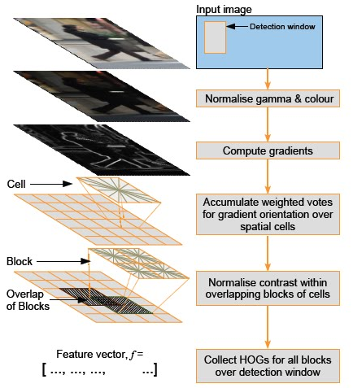
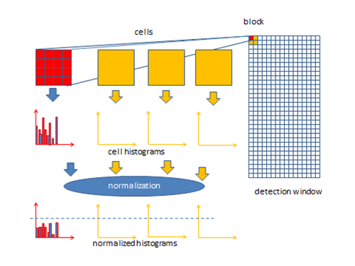
Histogram of Oriented Gradients
N. Dalal and B. Triggs. Histograms of oriented gradients for human detection. Computer Vision and Pattern Recognition, 2005. CVPR 2005. IEEE Computer Society Conference, 1:886-893, 2005

Slide 9
Project Plan
Term1: Research
Learnt how to use OpenCV
Learnt image processing techniques
Read & documented related research
Term2: Prototype
Detect the location of the face
Extract features from the face
Term3: Implementation
Train a learning algorithm
Predict emotions
Term4: Test & Evaluate
Test the accuracy of the results
Document results

Slide 10
References
P. Viola and M. J. Jones. Robust real-time face detection. International Journal of Computer Vision, 2(57):137-154, 2004.
N. Dalal and B. Triggs. Histograms of oriented gradients for human detection. Computer Vision and Pattern Recognition, 2005. CVPR 2005. IEEE Computer Society Conference, 1:886-893, 2005.

Slide 11
Demo

