Slide 1
AHED
Automatic Human Emotion Detection

Slide 2

Hello!
I am Retshidisitswe Lehata
Supervisor:
Mehrdad Ghaziasgar
Co-Supervisor:
Reg Dodds

Slide 3
Overview
Background
Recap of Proposed System
User Interface Update
Training the System
Overview of the System
Tools Used
Project Plan
References
Demo

Slide 4
Background
Customer service is a large revenue stream for some companies
Not all customers readily express their emotions verbally
A dissatisfied customer is more likely to walk away do their business elsewhere than complain

Slide 5
Recap of Proposed System
Automatically recognize human emotions
Using facial expressions
From live videos
Detecting the dominant emotion

Slide 6
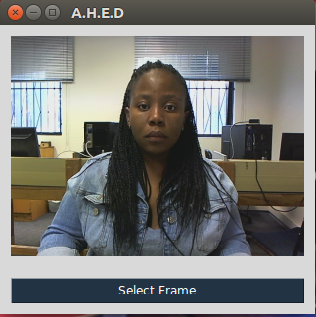
User Interface Update
Live video stream
Button to visualize feature extraction for a selected frame
Notes:
Live video stream
Button to visualize feature extraction for a selected frame

Slide 7
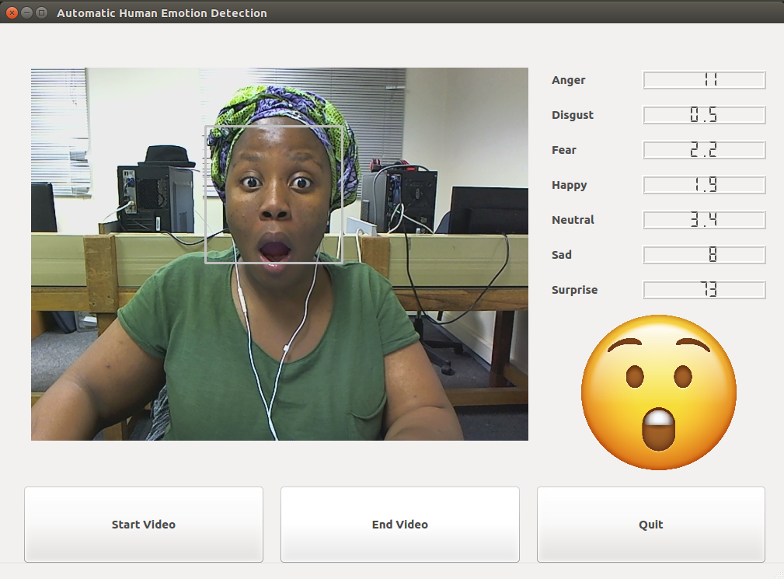
User Interface Update
Live video stream
Real time emotion classification
Emoji – Dominant emotion
Probability of all 7 emotions
Notes:
Live video stream
Button to visualize feature extraction for a selected frame

Slide 8
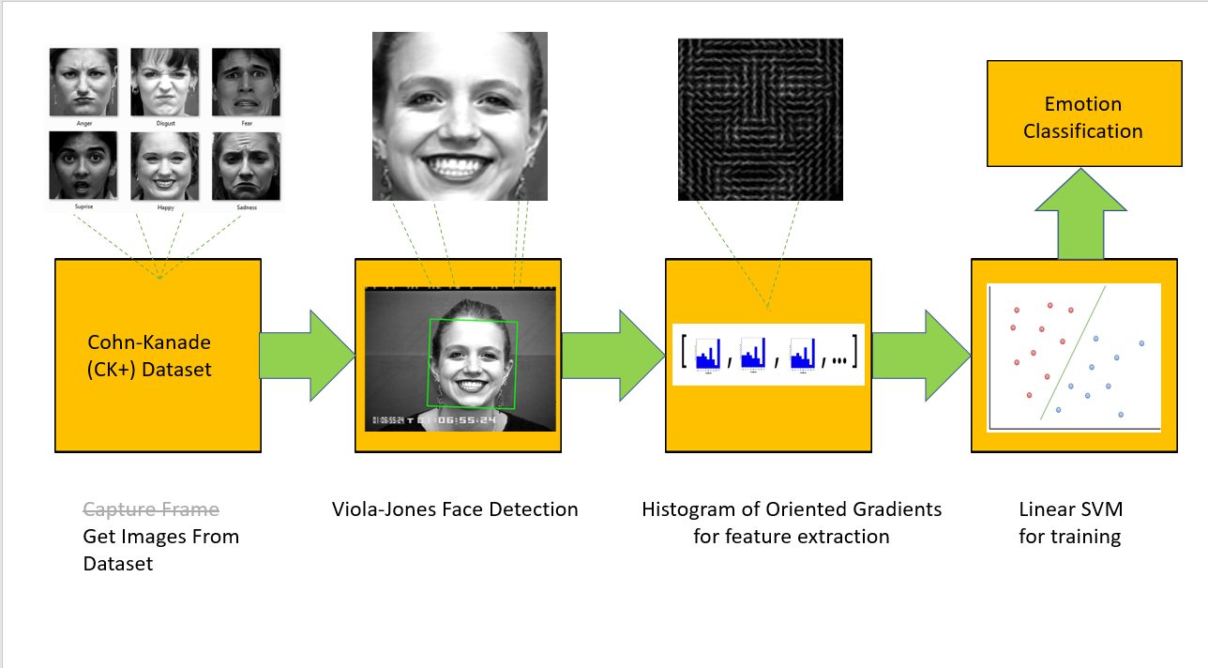
Training the System

Slide 9
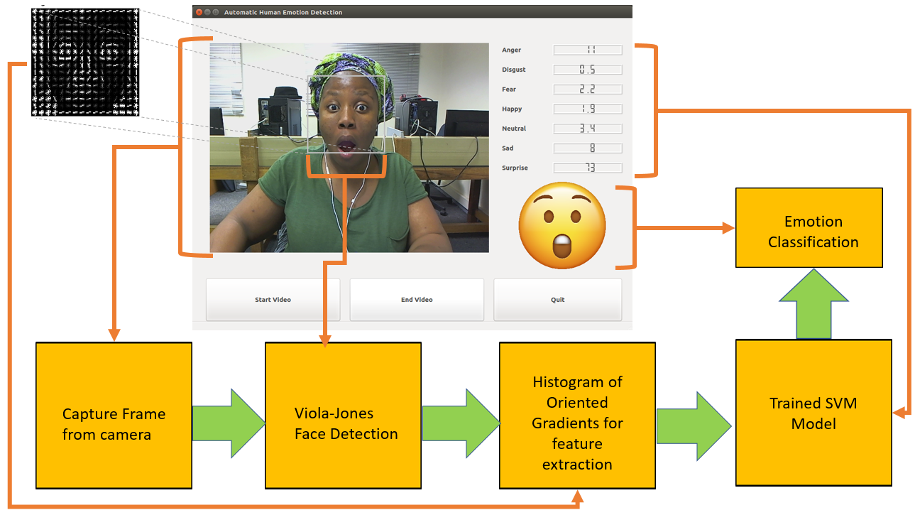
Overview of the System

Slide 10






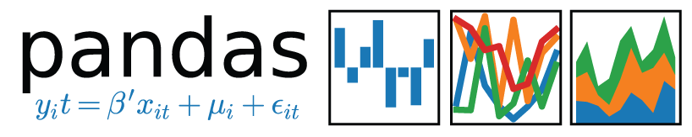
Tools Used

Slide 11
Project Plan
Term1: Research
Learnt how to use OpenCV
Learnt image processing techniques
Read & documented related research
Term2: Prototype
Detect the location of the face
Extract features from the face
Term3: Implementation
Train a learning algorithm
Predict emotions
Term4: Test & Evaluate
Test the accuracy of the results
Document results

Slide 12
References
P. Viola and M. J. Jones. Robust real-time face detection. International Journal of Computer Vision, 2(57):137-154, 2004.
N. Dalal and B. Triggs. Histograms of oriented gradients for human detection. Computer Vision and Pattern Recognition, 2005. CVPR 2005. IEEE Computer Society Conference, 1:886-893, 2005.
Chih-Wei Hsu, Chih-Chung Chang, Chih-Jen Lin, et al. A practical guide to support vector classification. 2003.

Slide 13







Demo
Angry
Disgust
Fear
Happy
Neutral
Sad
Surprise

