Slide 1
HELPING DISADVANTAGED YOUTH FIND EMPLOYMENT in web development

Slide 2
Supervisor: Prof William Tucker
Co- Supervisor: Prof Isabella Venter
Department of Computer Science
University of the Western Cape
CAMS Building
Email: 3229079@myuwc.ac.za
Website: http://www.cs.uwc.ac.za/~zamansure/
ZOË AMANSURE
BSc Computer Science
Honors

Slide 3
PROBLEM
SOLUTION
USER INTERFACE
STATE DIAGRAM
CLASS DIAGRAM
TIMELINE
DEMO
Q & A
Disadvantaged youth…
Low level of education
Little to no work experience
Absence of strong networks
Absence of resources

Slide 4
PROBLEM
SOLUTION
USER INTERFACE
STATE DIAGRAM
CLASS DIAGRAM
TIMELINE
DEMO
Q & A
R
Government provides SETA* funding for skills development
Corporate accepts unskilled youth
Unskilled youth are trained
A comprehensive but user-friendly LMS^{[1]}
For corporate companies
That trains disadvantaged youth
[1] LMS - Learning Management System
*Sector Education & Training Authority

Slide 5
PROBLEM
SOLUTION
USER INTERFACE
STATE DIAGRAM
CLASS DIAGRAM
TIMELINE
DEMO
Q & A

Slide 7
PROBLEM
SOLUTION
USER INTERFACE
STATE DIAGRAM
CLASS DIAGRAM
TIMELINE
DEMO
Q & A

Slide 9
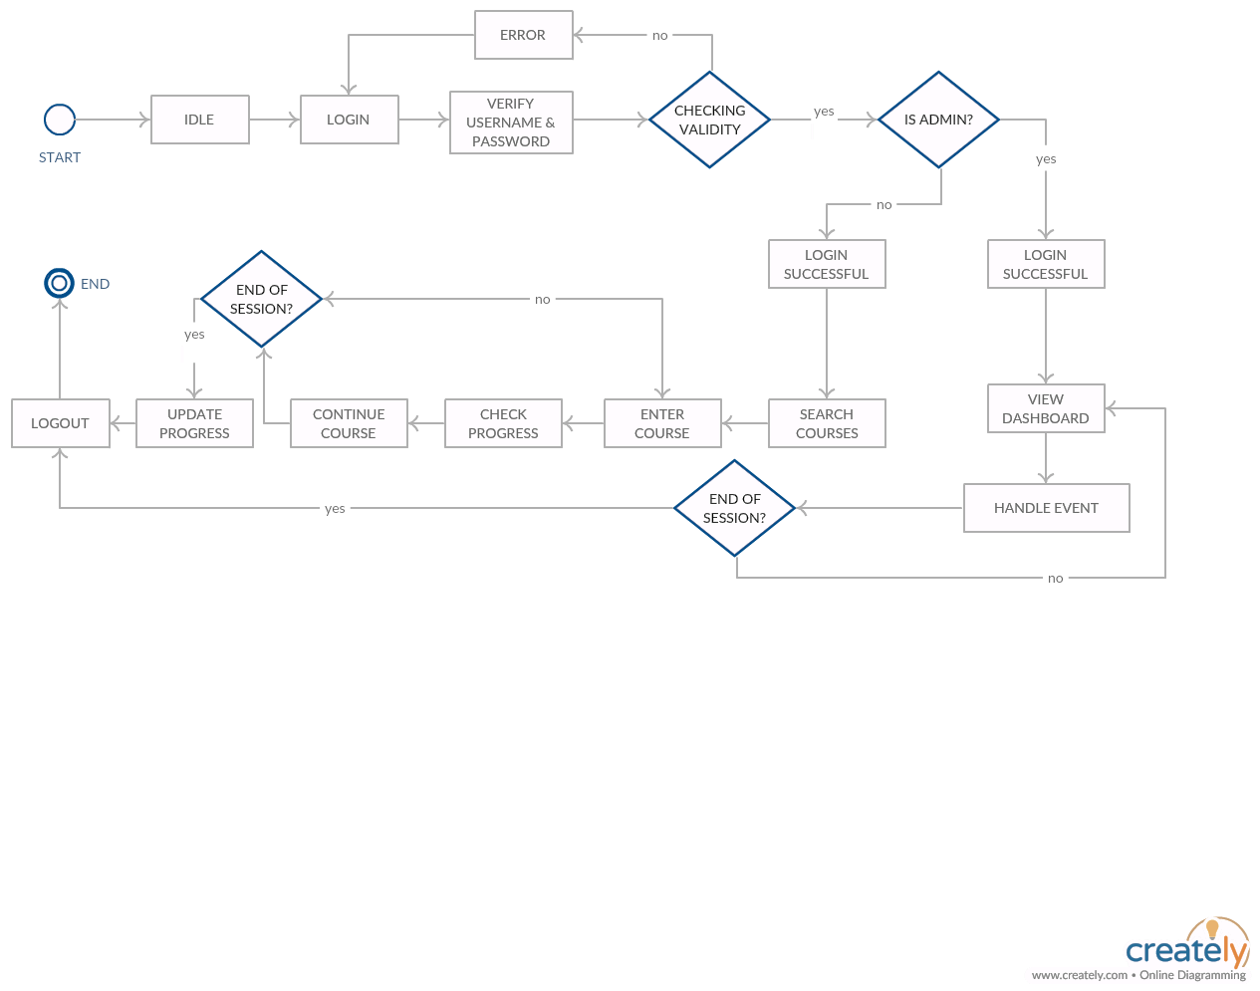
PROBLEM
SOLUTION
USER INTERFACE
STATE DIAGRAM
CLASS DIAGRAM
TIMELINE
DEMO
Q & A

Slide 10
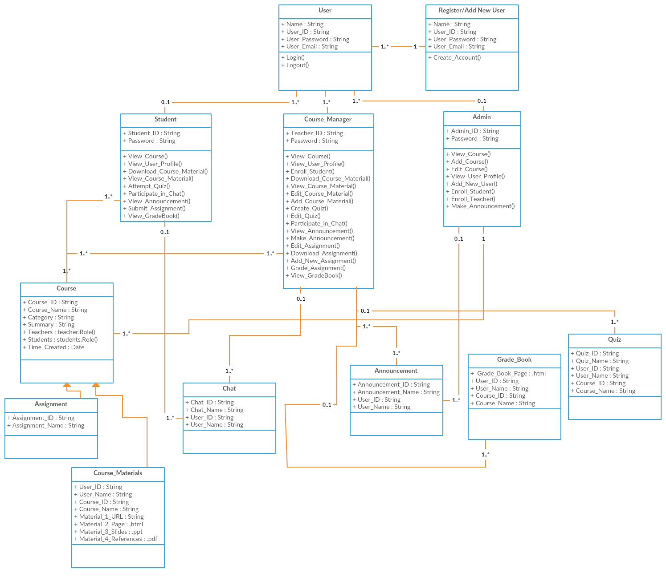
PROBLEM
SOLUTION
USER INTERFACE
STATE DIAGRAM
CLASS DIAGRAM
TIMELINE
DEMO
Q & A

Slide 11
SIMPLIFIED CLASS DIAGRAM

Slide 12
PROBLEM
SOLUTION
USER INTERFACE
STATE DIAGRAM
CLASS DIAGRAM
TIMELINE
DEMO
Q & A

Slide 13
PROBLEM
SOLUTION
USER INTERFACE
STATE DIAGRAM
CLASS DIAGRAM
TIMELINE
DEMO
Q & A
Scenario 1:
Intern (Zoë) completes an assignment for specific course
Scenario 2
Manager views progress of Intern (Zoë)

Slide 15
Q & A
PROBLEM
SOLUTION
USER INTERFACE
STATE DIAGRAM
CLASS DIAGRAM
TIMELINE
DEMO
Q & A
References
Bank, W. (2014, 05). South Africa - Labour Force Survey March 2005.
Diagrams – creately.com/app
Prototyping – Photoshop, inVision.com
Statistics South Africa. Pretoria, S. A. (2011). Stats SA. From https://web.archive.org/web/20151113203528/http://www.statssa.gov.za/publications/P03014/P030142011.pdf

