Slide 1
Adding a video notification reminder to SignSupport
Zakhele Ntuli
Supervisor: Prof IM Venter
Co Supervisor: Prof WD Tucker

Slide 2
Overview
SignSupport Overview
User Interface Specification
Low level design
High level design
Technologies
Project plan
Demonstration

Slide 3
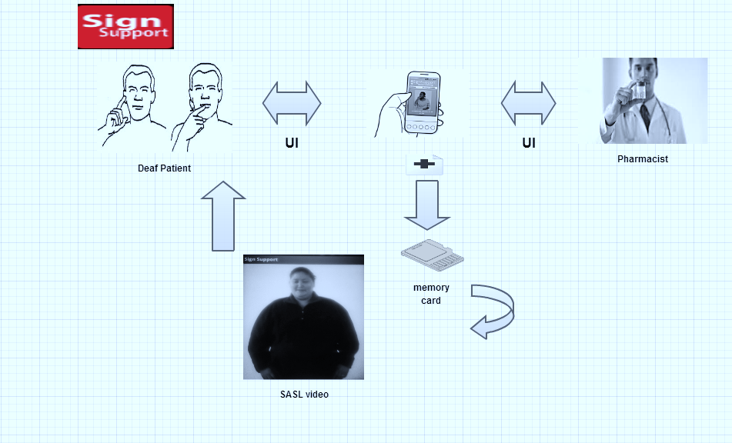
SignSupport

Slide 4
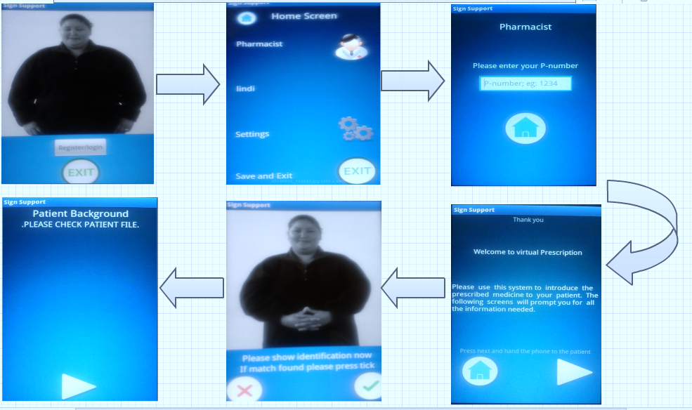
Current SignSupport UI

Slide 5
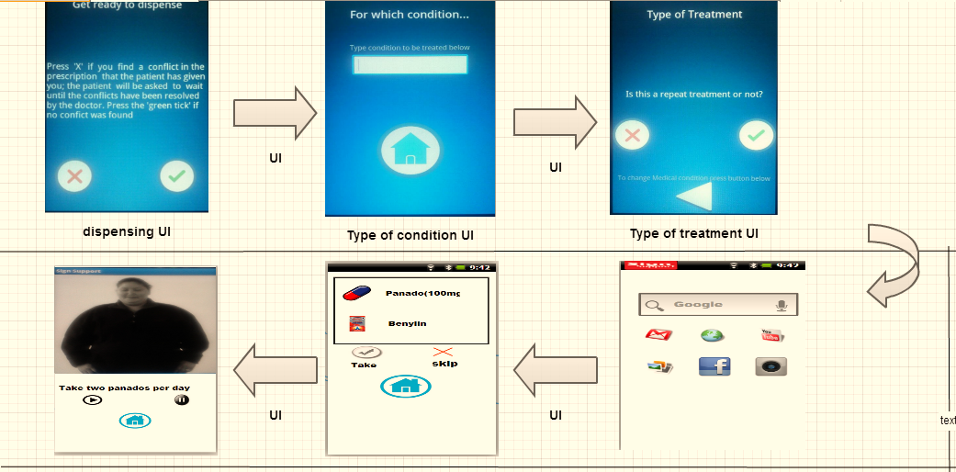
Addition to SignSupport UI

Slide 6
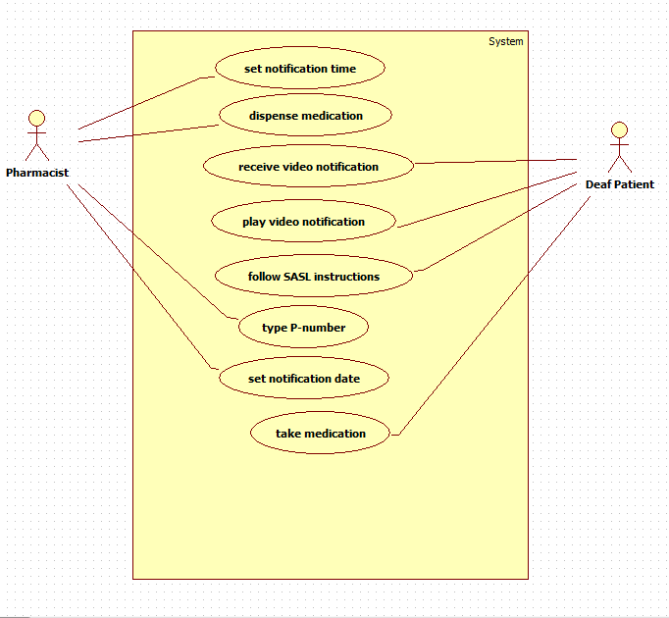
Pharmacist UI & Deaf UI

Slide 7
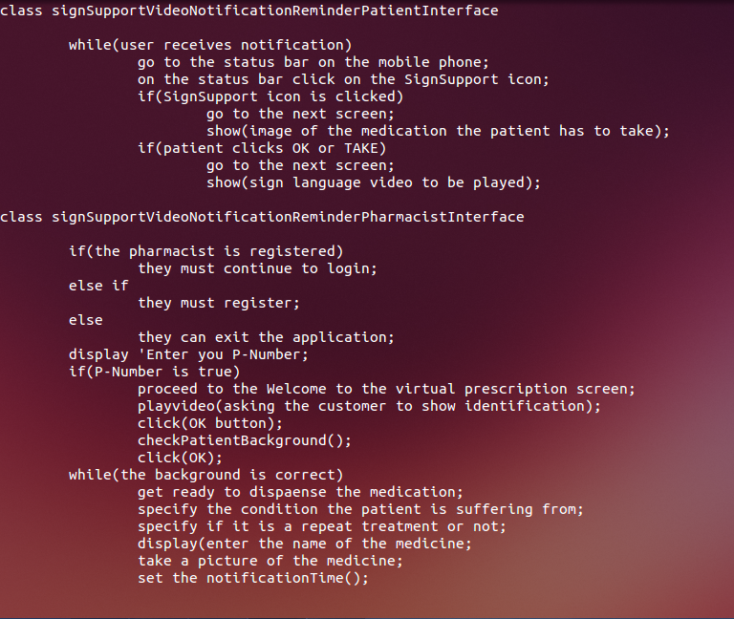
Low level design

Slide 8
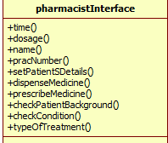
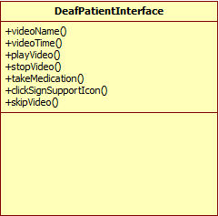
High level design

Slide 9



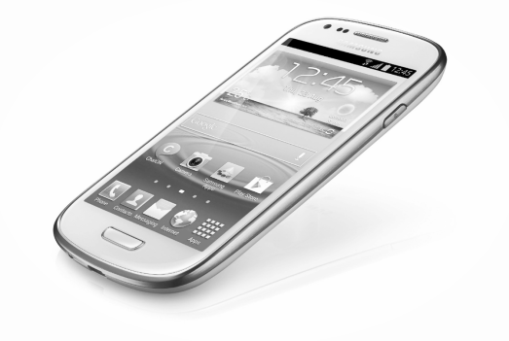
Technologies

Slide 10
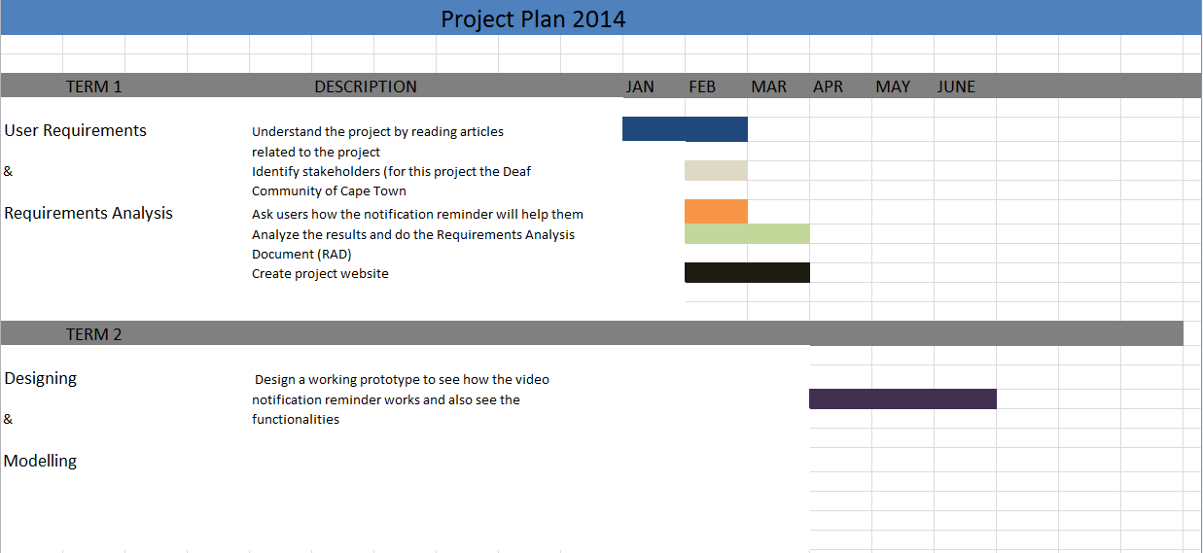
Project Plan

Slide 11
Demo
https://www.fluidui.com/editor/live/

Slide 12

Questions

